Slide 1


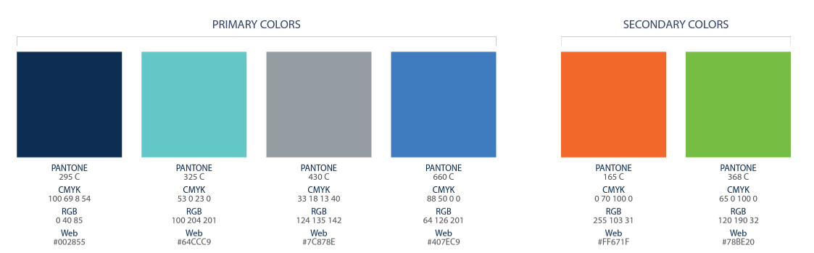

Slide 2

NEW IBO TRAINING
IBO Training
The SYSTEM for how to maximize earnings for your team and you!
YOU WILL LEARN
Onboarding
Build Your Team
3-Legged Stool of Success
Grand Opening Event
Compensation Plan
Earn $1,100 or More

Slide 3


BEFORE WE BEGIN
Get Ready to Learn
Take Screenshots
Take Notes

Slide 4


How to Earn Your First $1,100
YOU Enroll 6 Services
1
Teach and Help 1 Other
To Do the Same
2

Slide 5
Start here >>> MyACN.AI
Enroll
Complete your Profile
Train Your AI
Download & Install the App
Login
Complete Onboarding
LegacyPartners.biz
Team Events
Team Emails
Important Bookmarks

Slide 6
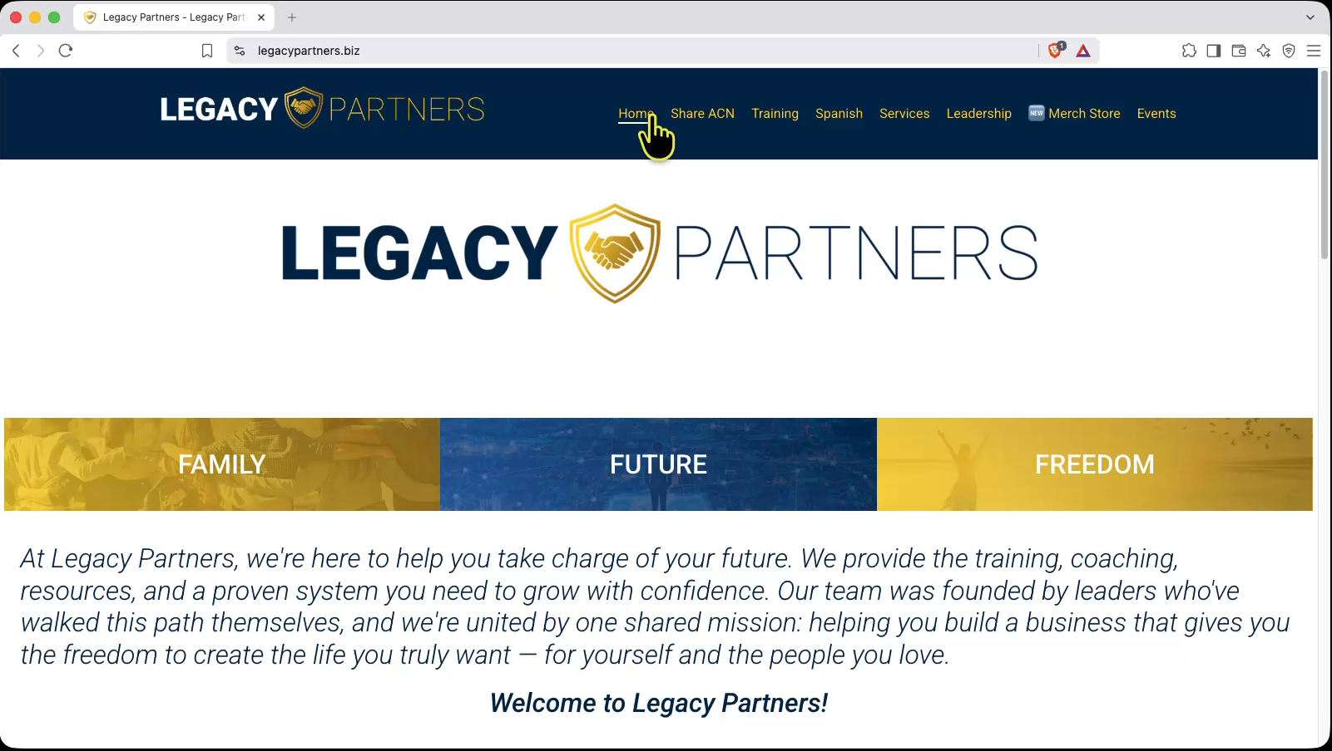
BEFORE ANYTHING ELSE
LegacyPartners.biz/Onboarding
ONBOARDING
✓ Onboarding Download
✓ ACN AI
✓ Emails
✓ Facebook Group
QUICKSTART
✓ How to Earn $1,100
✓ Build Your Team
✓ Launch Your Business
✓ XOOM & Impact Accreditation
✓ Downloads

Slide 7




SUCCESS MINDSET
The 3-Legged Stool of Success
VISION
MINDSET
“You must see it in your mind before you can hold it in your hand.”
— Les Brown
Make a decision
Embrace the learning curve
Ride the emotional roller coaster
Develop the right attitude
Have long-term thinking
SW / SW / SW / NEXT!
Never quit
Determine Your WHY

Slide 8
Compensation Plan
“It will show you where to focus your efforts to effectively build your business the right way!”

Slide 9



ACN Services - Point System
Services ▪ Range from 1 – 10 + Points
Customers ▪ May use multiple services
Security & Automation
Wireless
TV
High Speed Internet
Health Sharing
Electricity
Gas
Payment Processing
Identity Theft Protection (U.S.A)
Fintech Banking (Coming Soon)
LegacyPartners.biz
TheSVPSystem.com
See ACN Compensation Plan for full details.

Slide 10





How Customer/Service Points Work
5
POINTS
Health Sharing
4
POINTS
ID Theft Protection
Example
1 Customer
8
4 Services
POINTS
Mobile Service
20 Points
3
POINTS
Financial Services
See ACN Compensation Plan for full details.

Slide 11
Just Remember…
More Points = More $$

Slide 12


200!
150
100
75
Percentage you earn on your Personal Customers
Journey to 75 & 200 POINTS!
60
50
Why Personal Customers Matter!
Personal Customer Points
40
75 pts
25
20%
3%
5%
10%
14%
17%
Level 1 = 4%
Level 1 = 4%
Level 2 = 4%
Level 2 = 4%
Levels 1 - 2 Unlocked
TEAM
Level 3 = 4%
Level 3 = 4%
Level 4 = 4%
Level 4 = 4%
Levels 1 – 4 Unlocked
Level 5 = 4%
Level 5 = 4%
Levels 1 – 5 Unlocked
LegacyPartners.biz
TheSVPSystem.com
See ACN Compensation Plan for full details

Slide 13
Journey to 75 & 200 POINTS!
Percentage you earn on your Personal Customers
150
Why Personal Customers Matter!
200!
Personal Customer Points
75 pts
25
40
50
60
75
100
20%
3%
5%
10%
14%
17%
Level 1 = 4%
Level 1 = 4%
Level 2 = 4%
Level 2 = 4%
Levels 1 - 2 Unlocked
TEAM
Level 3 = 4%
Level 3 = 4%
Level 4 = 4%
Level 4 = 4%
Levels 1 – 4 Unlocked
Level 5 = 4%
Level 5 = 4%
Levels 1 – 5 Unlocked
See ACN Compensation Plan for full details

Slide 14
Promote from Left to Right
Overriding Customer Acquisition Bonuses (CAB)
CQ
CQ
ETL
RC
RD
RVP
SVP
SVP
Platinum
Up to
$150
Up to
$250
Up to
$350
Up to
$400
Up to
$450
$50
The more customer points you have, the higher your rank!
LegacyPartners.biz
TheSVPSystem.com

Slide 15
OVERRIDING CUSTOMER ACQUISITION BONUSES (CAB)
Promote from Left to Right
CQ
ETL
RC
RD
RVP
SVP
SVP
Platinum
Up to
$150
Up to
$250
Up to
$350
Up to
$400
Up to
$450
$50
The more customer points you have, the higher your rank!

Slide 16



EARNED POSITIONS
Independent Business Owner (IBO)
CQ
ETL
RC
RD
CQ
ETL
RC
RD
Minimum Requirement
to earn all
ACN Compensation
Personal
6 Services
16 Customer Points
Personal
16 Customer Points
Personal
16 Customer Points
Personal Customers
Personal & Team
Customers
Personal & Team
Customers
Personal & Team
Customers
3 Services
8 Cust. Pts.
30* Cust. Pts.
*Minimum 15 Downline
200 Cust. Pts.*
600 Cust. Pts.*
* Max Credit
100 Customer Points Per Leg
* Max Credit
200 Customer Points Per Leg
15
100
100
200
200
200
See ACN Compensation Plan for full details.

Slide 17
How to Earn Your First $1,100
YOU Enroll 6 Services
1
Teach and Help 1 Other
To Do the Same
2

Slide 18

YOUR FIRST GOAL
First Goal
GET CUSTOMER QUALIFIED
EARN YOUR FIRST BONUS
$300 +
in 2
CQ

Slide 19
EARNED POSITIONS
Independent Business Owner (IBO)
CQ
ETL
RC
RD
CQ
ETL
RC
RD
Minimum Requirement
to earn all
ACN Compensation
Personal Customers
3 Services
8 Cust. Pts.
See ACN Compensation Plan for full details.

Slide 20







STEP 01
Your First 3 Services
CHOOSE YOUR 3
1
2
3
SERVICE
SERVICE
SERVICE

Slide 21


STEP 02
Acquire 3 More Services
ENERGY
TELEVISION
For a total of 6 services
HEALTH
COVERAGE
Earn Another
$400!
MOBILE
SECURITY &
AUTOMATION
HIGH SPEED
INTERNET
PAYMENT
PROCESSING
ID THEFT
PROTECTION
FINANCIAL
SERVICES
Notes:
Your goal when you get started is to get in the black ASAP

Slide 22
MONTHLY PERSONAL CUSTOMER BONUSES
Decide How Much You Want to Earn
Paid on any services YOU acquire*
01
3 Services
& 8 Points
$300
per month
02
6 Services
& 16 Points
$700
per month
03
9 Services
& 24 Points
$1,100
per month
PLUS $400 for every additional 3 Services & 8 Points
*Refer to the ACN Compensation Plan for complete details.
Notes:
Your goal when you get started is to get in the black ASAP

Slide 23













Notes:
Four Sources of Customers
The Most Important Customer is YOU

Slide 24













Slide 25

How to Earn Your First $1,100
YOU Enroll 6 Services
Teach and Help 1 Other
To Do the Same
2

Slide 26
OVERRIDING CUSTOMER ACQUISITION BONUSES
Promote from Left to Right
CQ
ETL
CQ
ETL
RC
RD
RVP
SVP
Up to
$150
Up to
$250
Up to
$350
Up to
$400
$50
Notes:
˙

Slide 27
ETL
In 30
BUILD YOUR TEAM
Enroll 6 Services
Help 1 IBO to do the same

Slide 28
EARNED POSITIONS
Independent Business Owner (IBO)
CQ
ETL
RC
RD
CQ
ETL
RC
RD
Minimum Requirement
to earn all
ACN Compensation
Personal
6 Services
16 Customer Points
Personal Customers
Personal & Team
Customers
3 Services
8 Cust. Pts.
30* Cust. Pts.
*Minimum 15 Downline
15
See ACN Compensation Plan for full details.

Slide 29
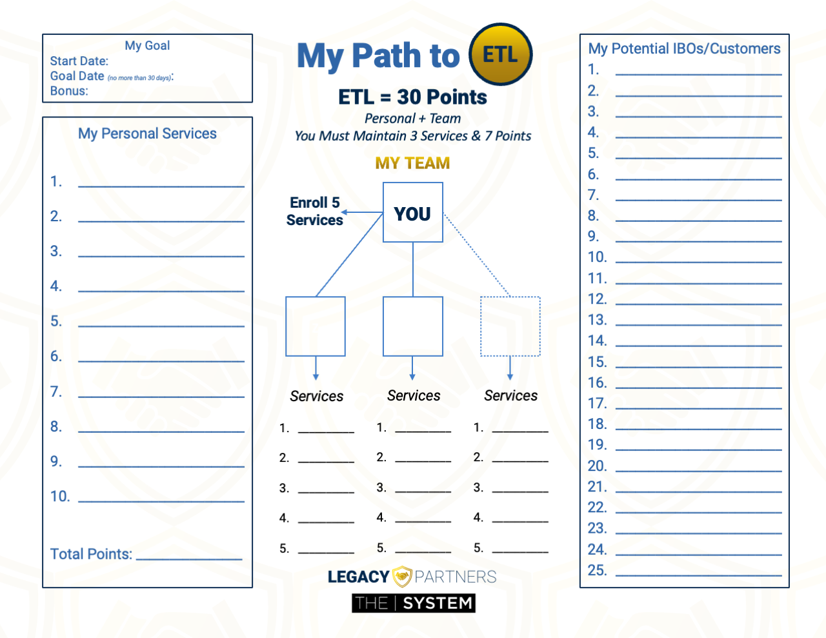
Next
YOUR TOOLs
PATH to ETL
PATH to ETL
MyPathToETL.com
MyPathToETL.com

Slide 30




PROSPECTING
Filling Your Pipeline
Make Your List – 100 Names & Numbers
⭐️ Don’t Prejudge!
Your ”A” List
Business Owners/Entrepreneurs
Success-Minded/Money-Motivated
Direct Sales Experience
Influential
Real Estate Professionals
Everyone Else

Slide 31

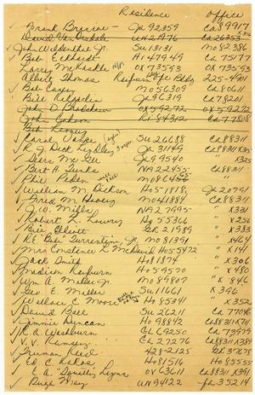
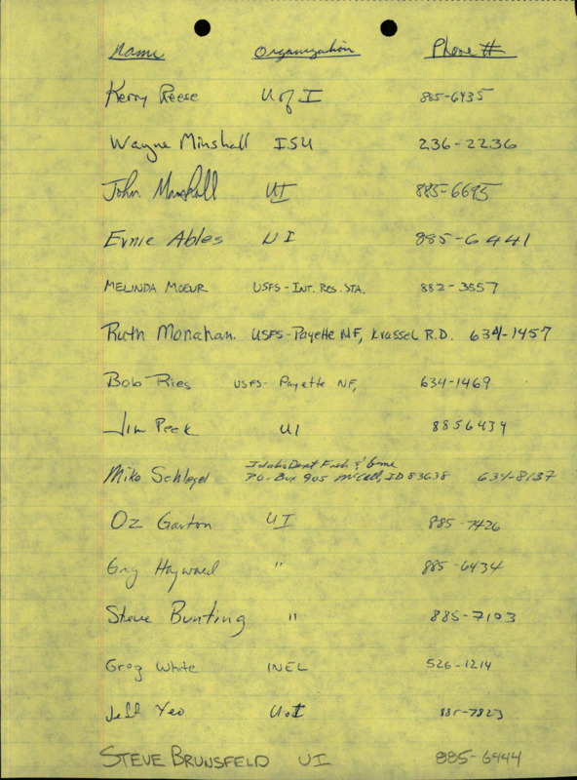

Build Your Team
Help at Least 1 Other to Do the Same
Schedule
Your
Memory Jogger
LegacyPartners.biz/Onboarding
Refer to the ACN Compensation Plan for complete details.

Slide 32






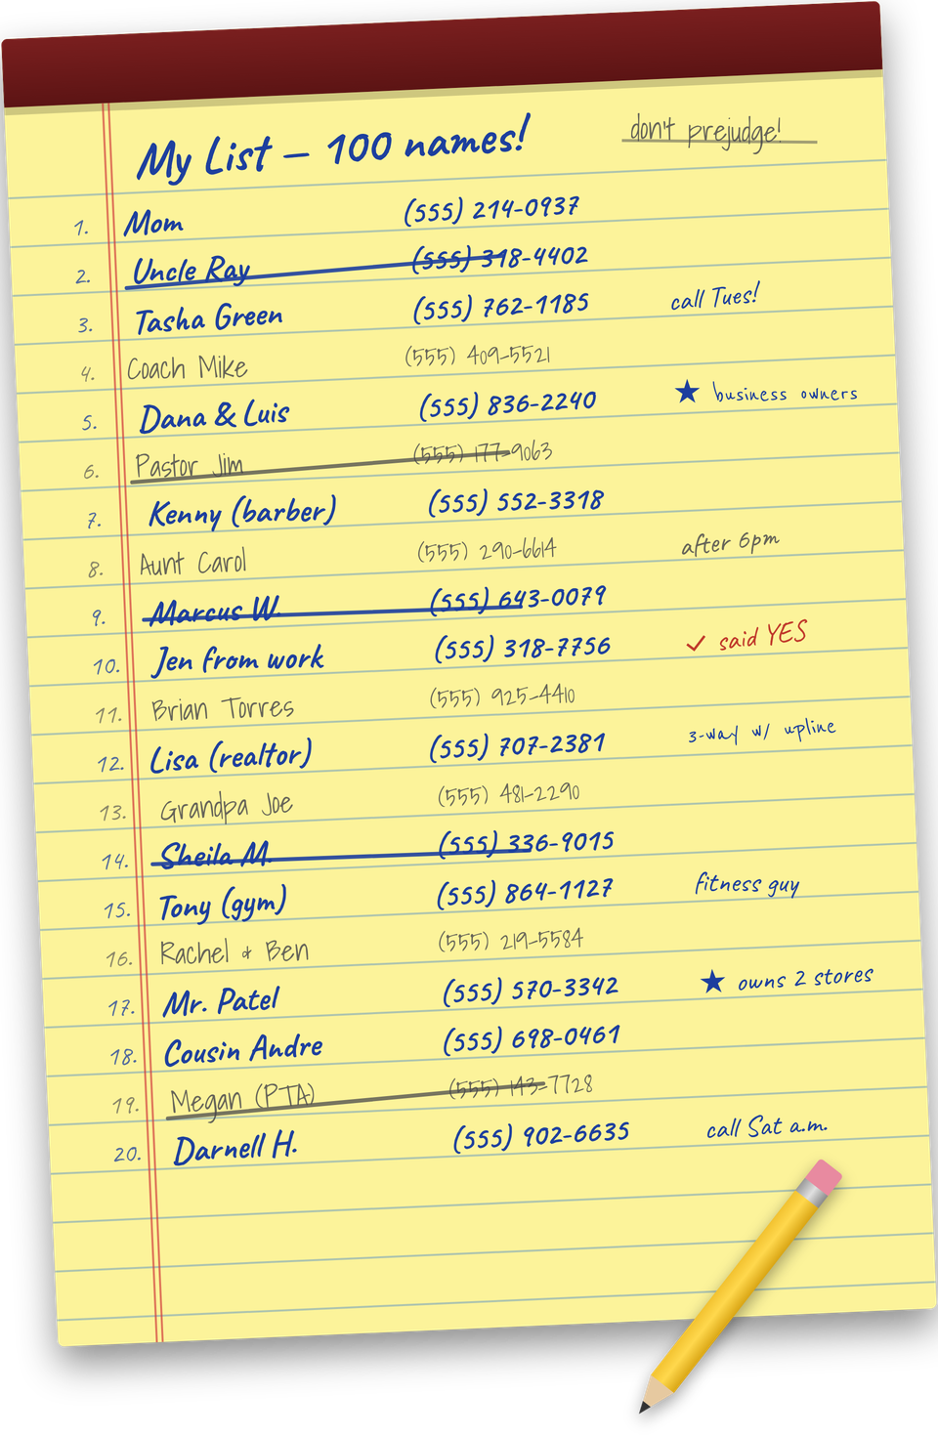
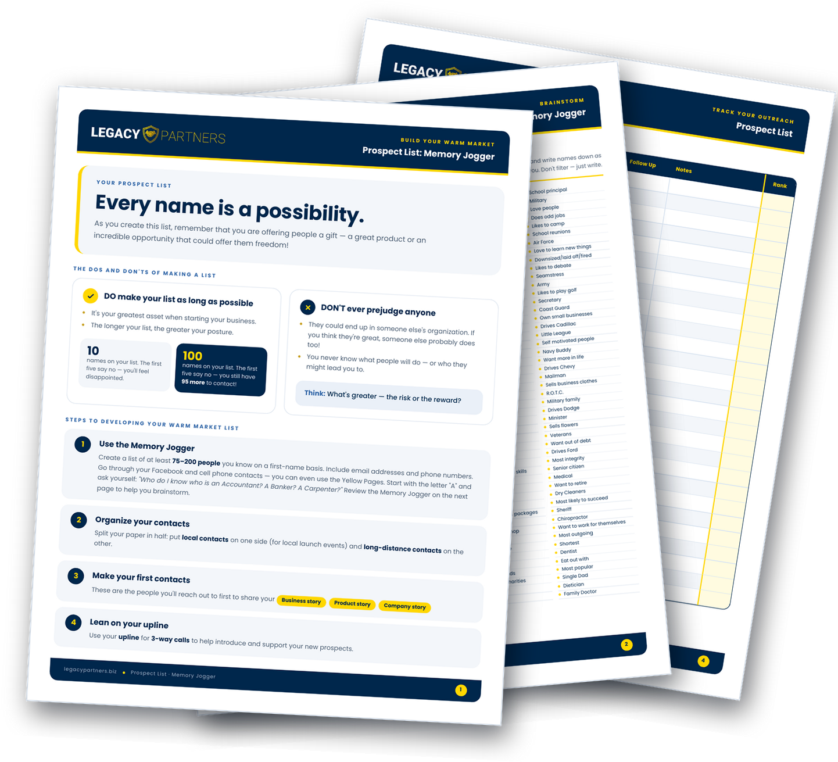
Notes:
Now that you know what to do, let's talk about how to do it.
LAUNCH YOUR BUSINESS!

Slide 33


🏠
Set A Date In The
Next 24 Hours
PICK A TIME THAT
WORKS FOR YOU
In-Person Event
Build Relationships
Fluid Conversations
Networking
Follow Up Conversations
Relaxed Environment
Virtual Event
Attendees can join from a distance
Less time-consuming
Attendees can watch from home
Weather is not an issue
Your “A” List
Business Owners
Network Marketing Experience
$100,000 Earners
Everyone Else
LegacyPartners.biz
TheSVPSystem.com
Notes:
Now that you know what to do, let's talk about how to do it.
LAUNCH YOUR BUSINESS!

Slide 34








Slide 35


LAUNCH
Your Business
LegacyPartners.biz
TheSVPSystem.com
Notes:
Now that you know what to do, let's talk about how to do it.
LAUNCH YOUR BUSINESS!

Slide 36
How to Invite Guests
to Your Grand Opening!

Slide 37












Slide 38



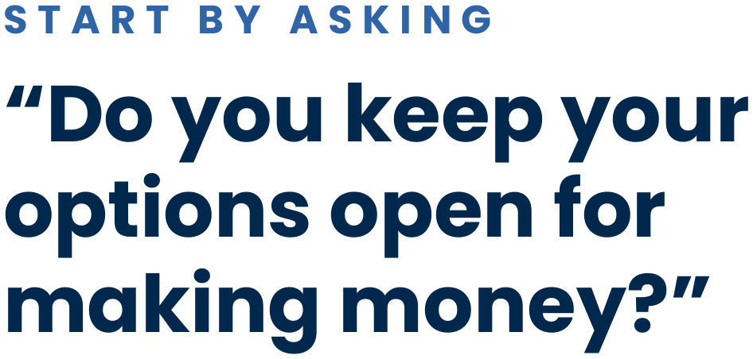







Slide 39

😎
💥 Be New
💥 Talk about a person, not the thing
💥 Essential Services
💥 3-Way Call
😬
What If They Have Questions…
LegacyPartners.biz
TheSVPSystem.com

Slide 40





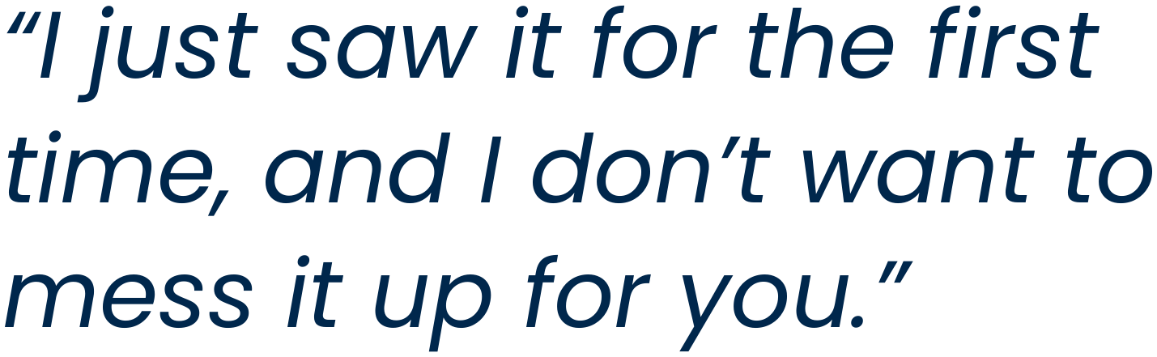


Slide 41





GRAND OPENING
Launch Checklist
1
2
3
Send a Text Reminder
To your guests the day before & the same day
Home Ready for Guests
Limit distractions (kids & pets)
Professional Background
Camera on, well-lit room. Your guests are watching YOU!
4
5
6
Test All Your Tech
Mic, web cam or TV connection
Role of Host
Fill the event & introduce the speaker and opportunity with enthusiasm
Pay Attention
Never interrupt the presenter!

Slide 42











Slide 43
How to Earn Your First $1,100
YOU Enroll 6 Services
1
Teach and Help 1 Other
To Do the Same
2

Slide 44
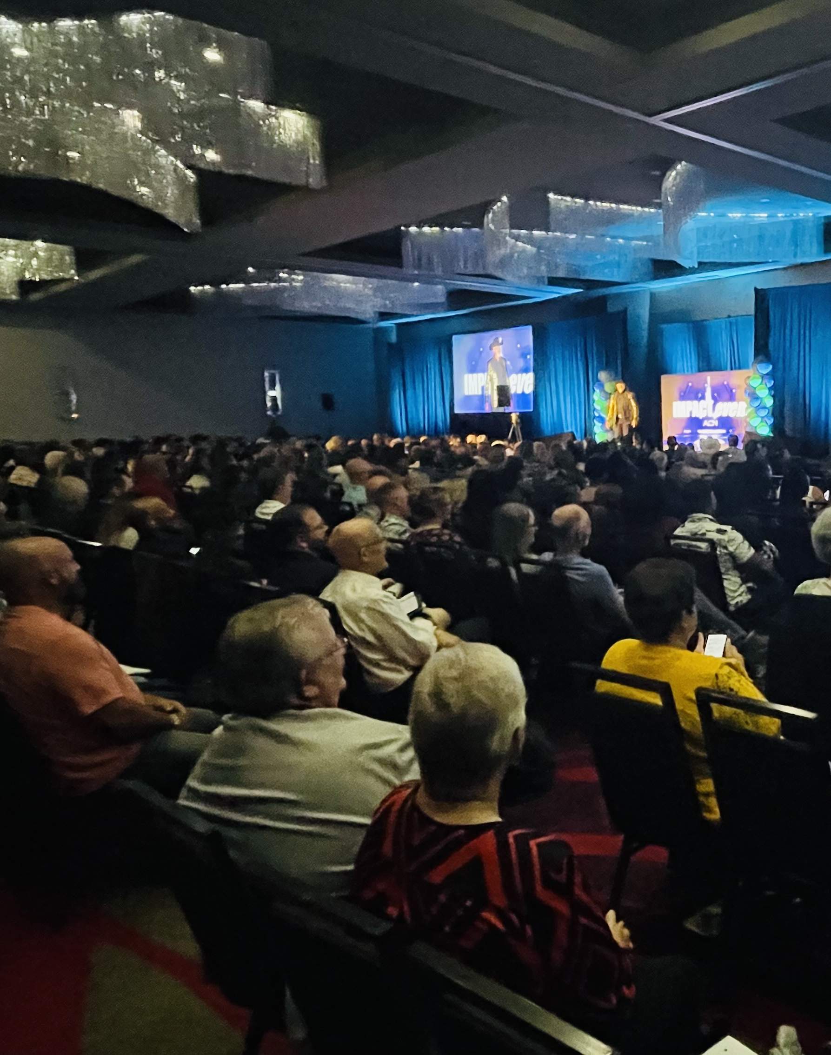
YOUR
BUSINESS LAUNCH

Slide 45
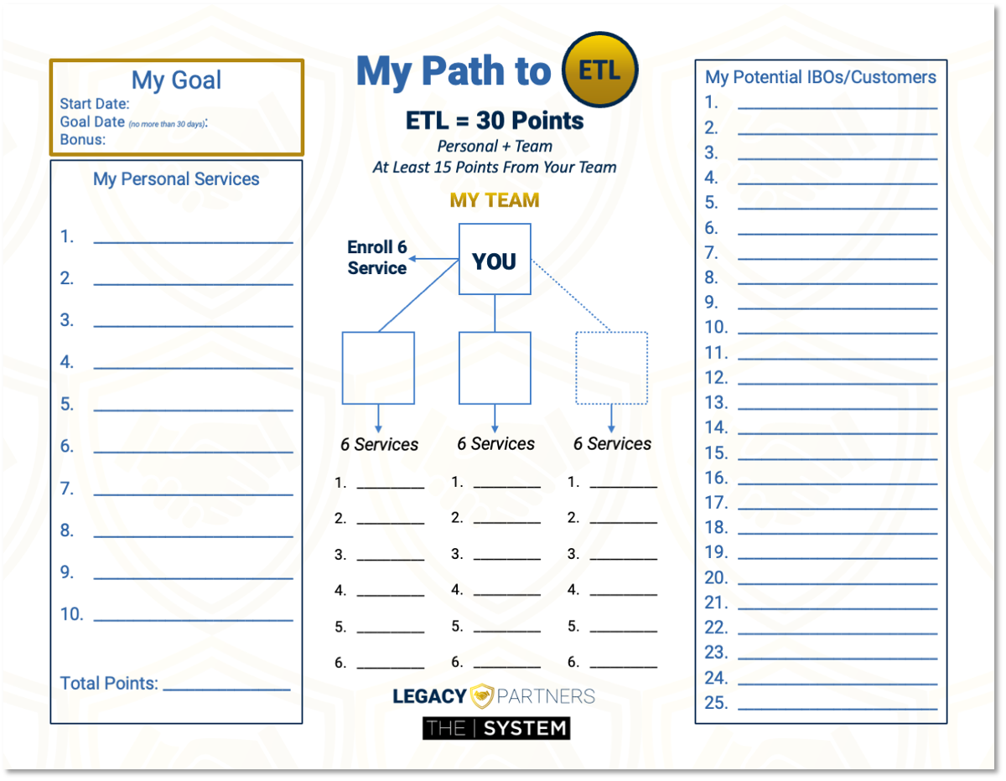
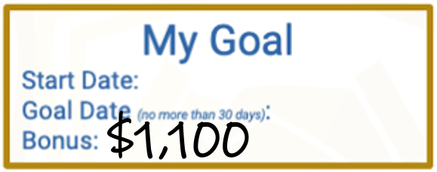
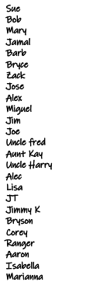
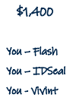
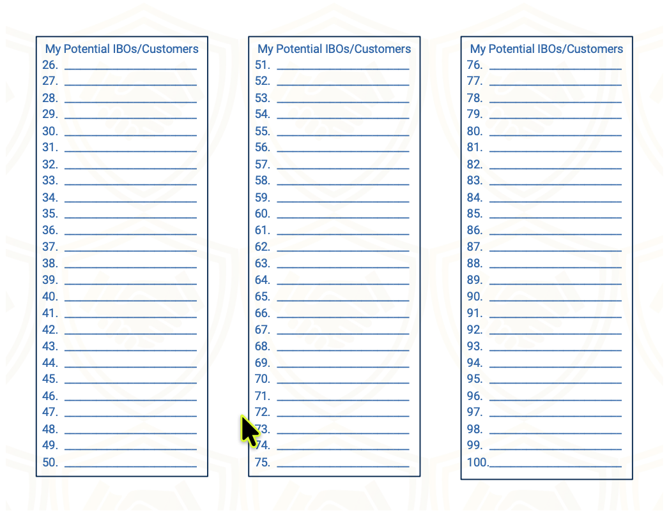



ETL
Your Goal
$1,100
Personal Customer Bonuses
$300
+ $400
ETL
3 Services
$1,400
3 Services
ETL in 30 Days
+ $400
6
1
Total
$1,100
*See ACN Compensation Plan for full details. Your results may vary. Earnings are not guaranteed.

Slide 46
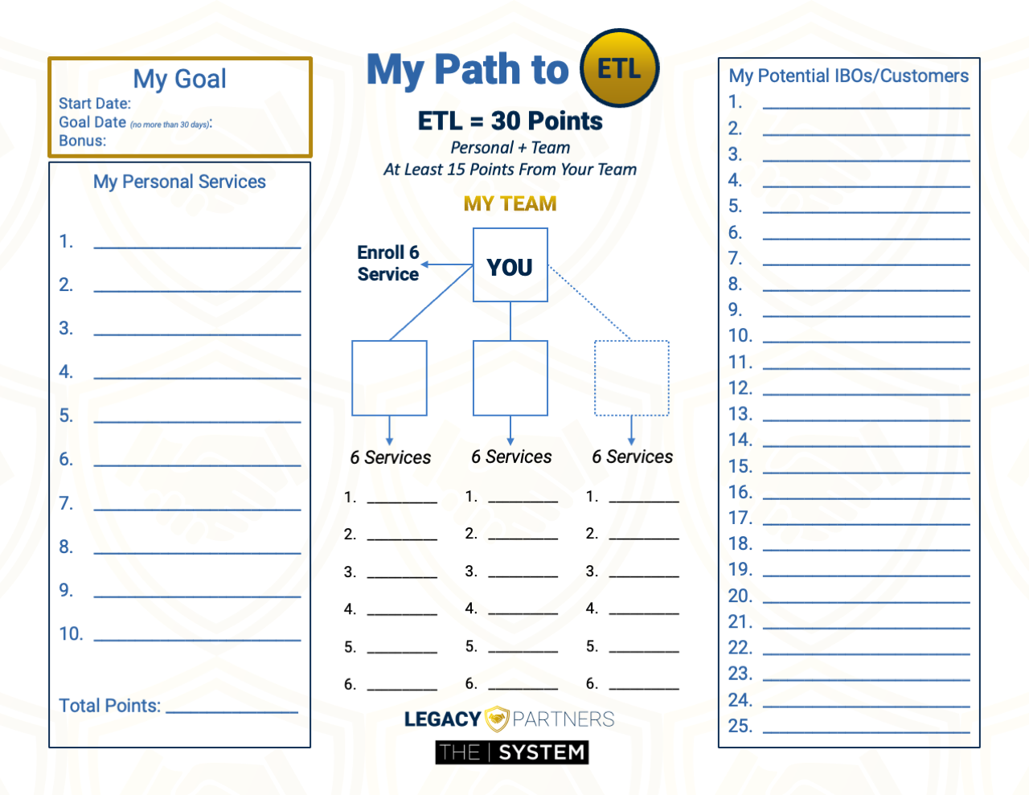
You = 3 Services
+ 3 Services = 6
Team = 6 Services
$1,400
Total = 12 Services
Personal Customer Bonus
$400
ETL
Personal Customer Bonus
$600
ETL in 30 Days
$400
*See ACN Compensation Plan for full details. Your results may vary. Earnings are not guaranteed.

Slide 47
You = 3 Services
+ 3 Services = 6
Sponsor 1 Person
Who does the same
Zack:
Enrolls 6 Services
Personal Customer Bonus
$400
ETL
Personal Customer Bonus
$600
ETL in 30 Days
$400
$1,400
$1,000
$400
*See ACN Compensation Plan for full details. Your results may vary. Earnings are not guaranteed.

Slide 48
EXAMPLE · YOUR FIRST 20–30 DAYS
20–30 Days to ETL
Enroll 6 Services | Help 1 Other Do the Same
WHAT YOU DO
HELP YOUR TEAM
DAY 1
DAY 2
DAY 3
DAY 4–7
DAY 4–8
DAY 4–10
DAY 11
DAY 14–17
DAY 14–18
DAY 20
Enroll as an IBO + enroll 3 services
Schedule Grand Opening + make your list
Invite guests
Your Grand Opening
Enroll 3 more services
Sponsor 1 (or 2) biz partners
Help new partner enroll 3 services
New IBOs have their Grand Opening
New IBOs have 6 services each
You promote!
YOUR PERSONAL CUSTOMER BONUS
$700 Personal Customer Bonus
+ $400 ETL Bonus
= $1,100
ETL
3 Services = $300
6 Services =
$700
*Example only. See the ACN Compensation Plan for full details.

Slide 49


CONGRATULATIONS!!!
ETL
6
$50
Zack
Barb
6
6
$50
$50
3 Services
$50
3 Services
3 Services
$50
3 Services
$50
3 Services
3 Services
*See ACN Compensation Plan for full details.
Your results may vary. Earnings are not guaranteed.
Notes:
Quick Start
Build Confidence - You and Company
Get Paid
$500 Bonus for enrolling 30 customers between you and your team
Specifics from the person who enrolled you or invited you.
*****Now that you know what to do, let's talk about how to do it.

Slide 50
Opportunity for Exponential Growth*
Level
IBOs
Income
1
3
$28.80
You sponsor 3 biz partners and each of them sponsor 3, down 5 levels.
2
9
$86.40
3
27
$259.20
Hypothetical Example
They enroll an average of
6 services each.
4
81
$777.60
5
243
$2,332.80
Total Monthly Residual Income from your Team
$3,484.80
*The hypothetical used in this presentation are for illustrative purposes only and not meant to imply that they are typical. Success as an ACN Independent Business Owner is not guaranteed but rather influenced by an individual’s specific efforts. Not all Independent Business Owners make a profit, and no one can be guaranteed success as an ACN Independent Business Owner.

Slide 51
Opportunity for Exponential Growth*
Level
IBOs
Income
1
3
$24
$48
You sponsor 3 IBOs and each of them sponsor 3 down 5 levels.
$72
2
9
$144
Hypothetical Example
3
27
$216
$432
They enroll an average of
10 services each.
They enroll an average of
5 services each.
4
81
$648
$1,296
$1,944
5
243
$3,888
$5,808
Total Monthly Residual Income from your Team
$2,904
Total Monthly Residual Income from your Team
*The hypothetical used in this presentation are for illustrative purposes only and not meant to imply that they are typical. Success as an ACN Independent Business Owner is not guaranteed but rather influenced by an individual’s specific efforts. Not all Independent Business Owners make a profit, and no one can be guaranteed success as an ACN Independent Business Owner.

Slide 52
BE A PROFESSIONAL
SORTER
Sorting is fun!
No one likes being convinced.
Be a professional.
Listen, sort and move on.
SW, SW, SW, SW, NEXT!
Some will… some won’t… so what… someone’s waiting!

Slide 53


YOUR NEXT MOVES
Call to Action 🏆
01
02
Enroll and become
CQ in 2
Schedule your
Grand Opening
Home or Zoom
03
04
Use the Inviting Blueprints to invite guests to your
Grand Opening
LegacyPartners.biz
Earn $1,100
Enroll 6 services
Help 1 other do the same

Slide 54
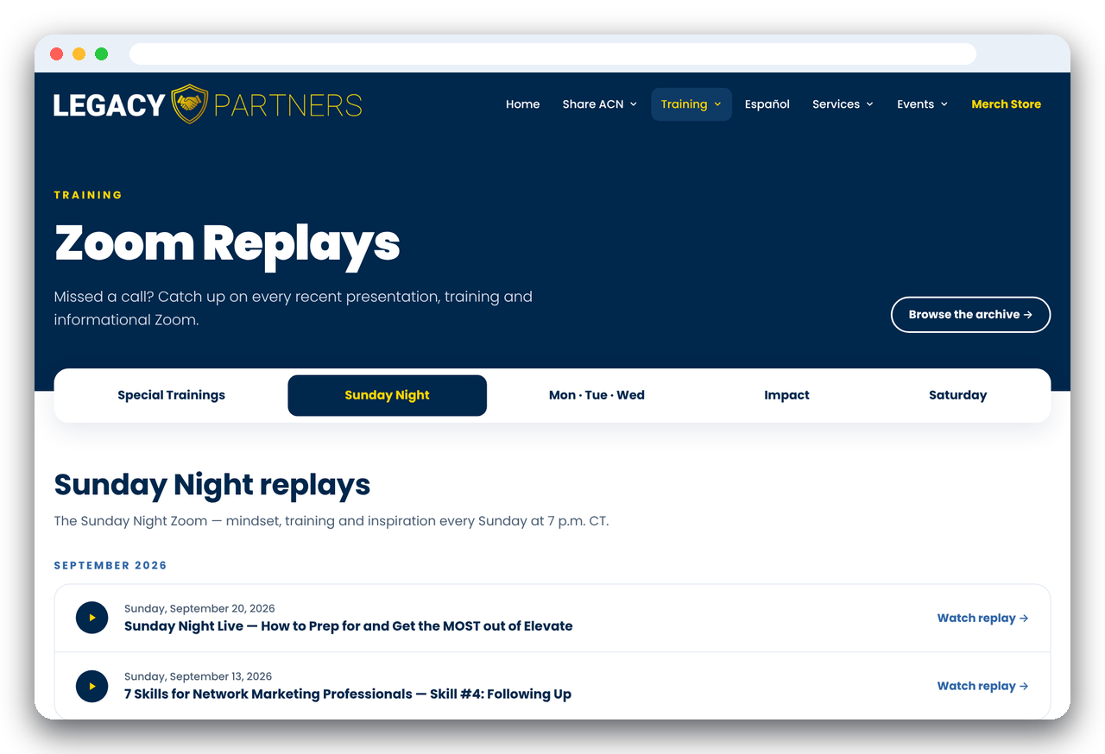
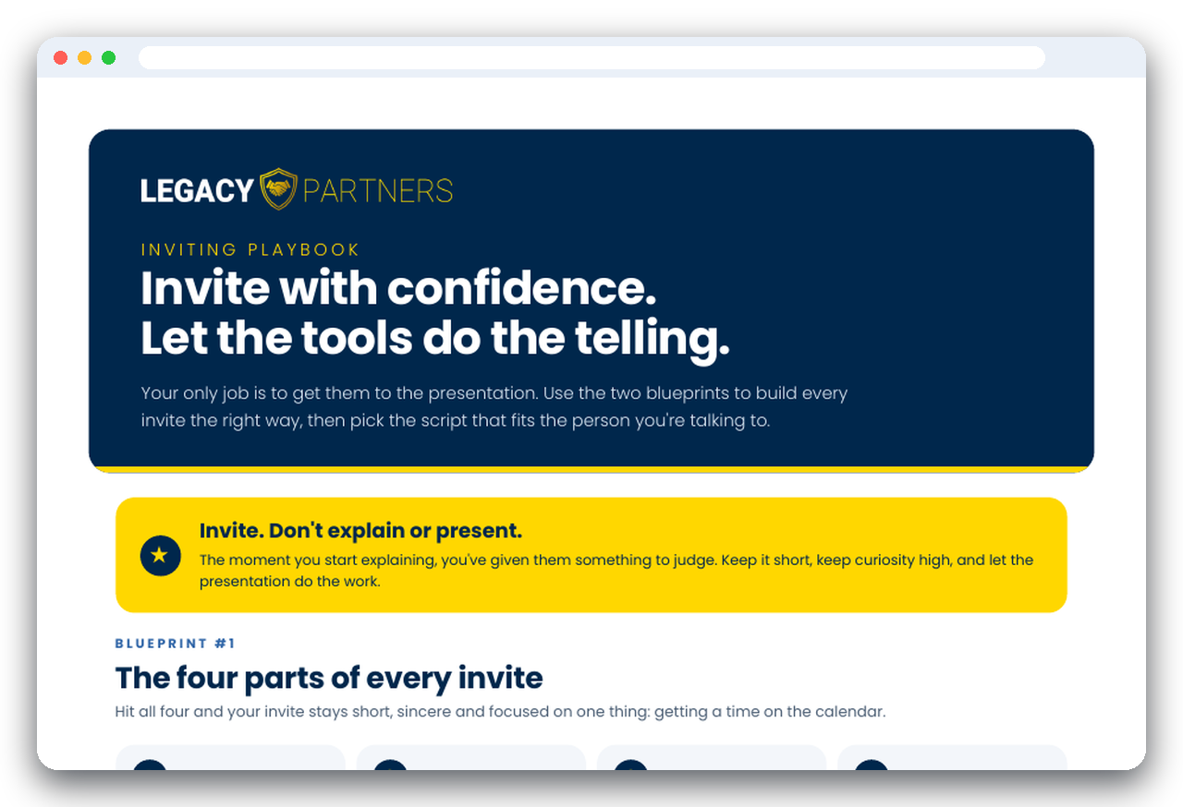



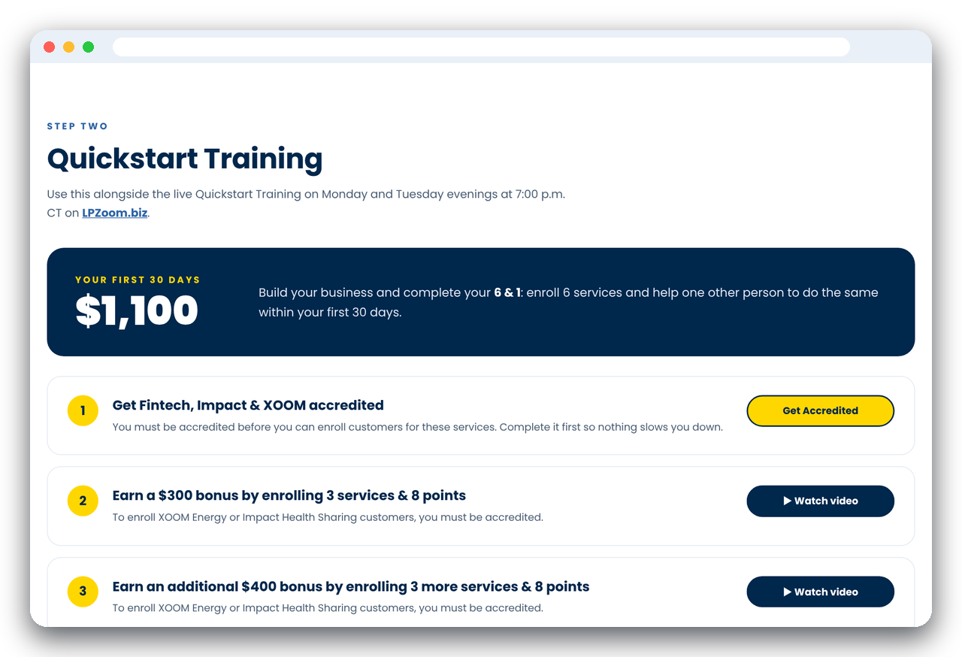
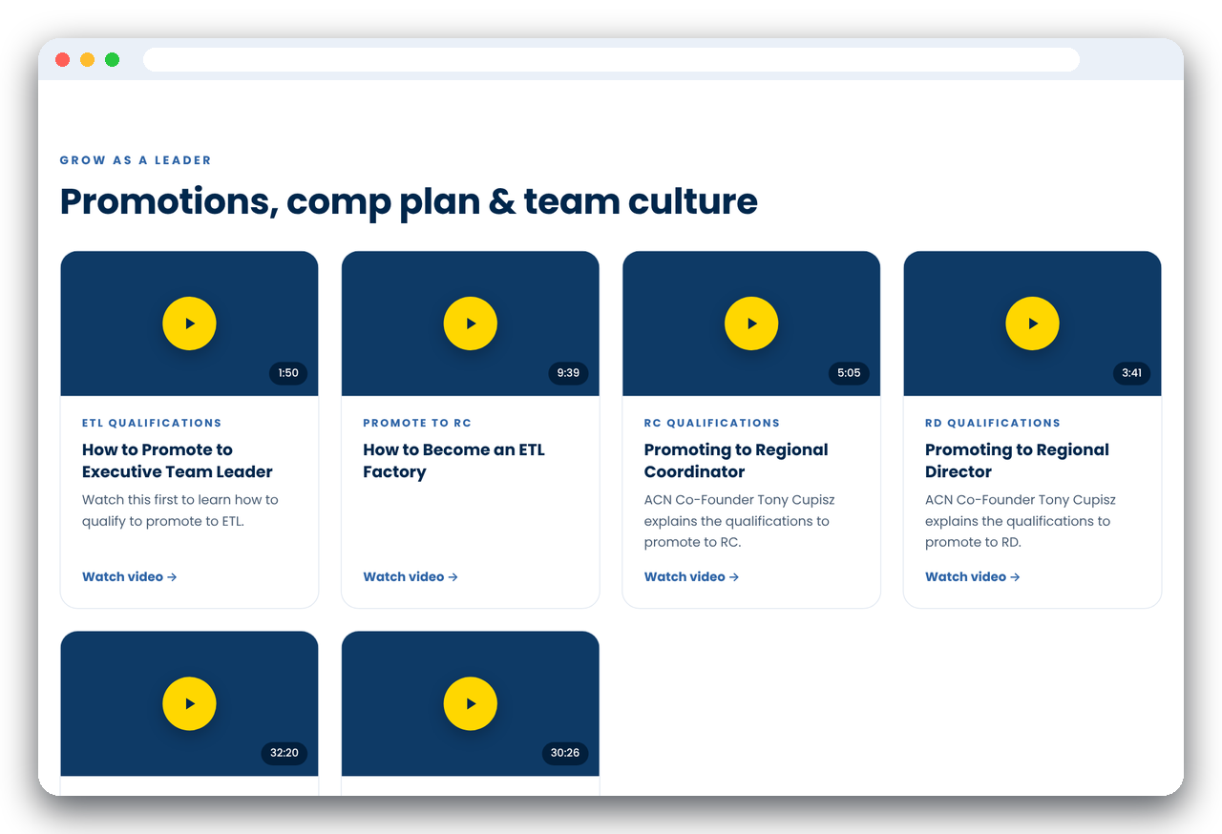





Slide 55


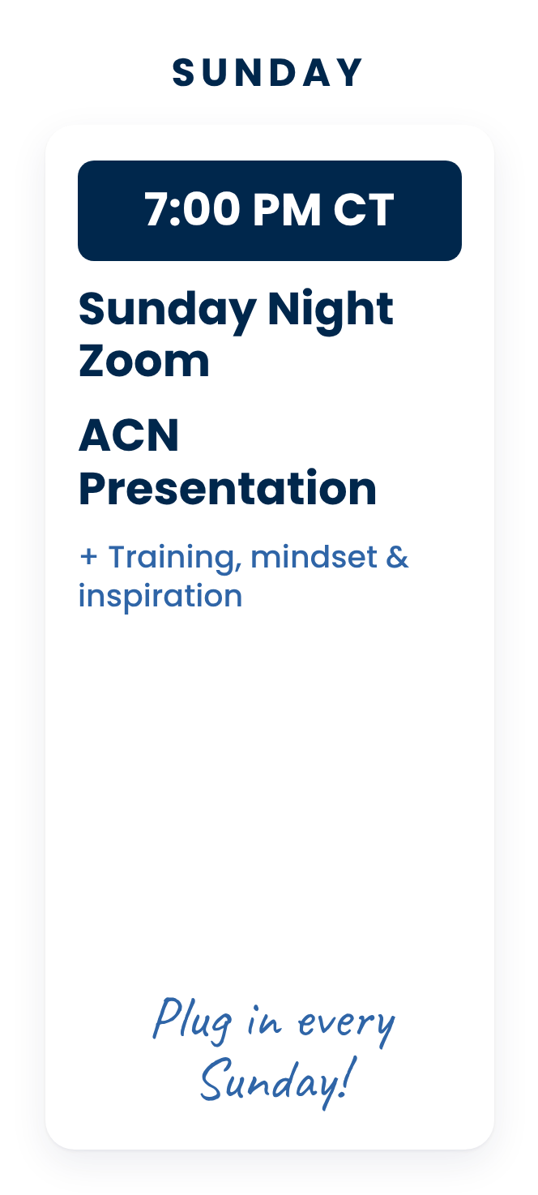
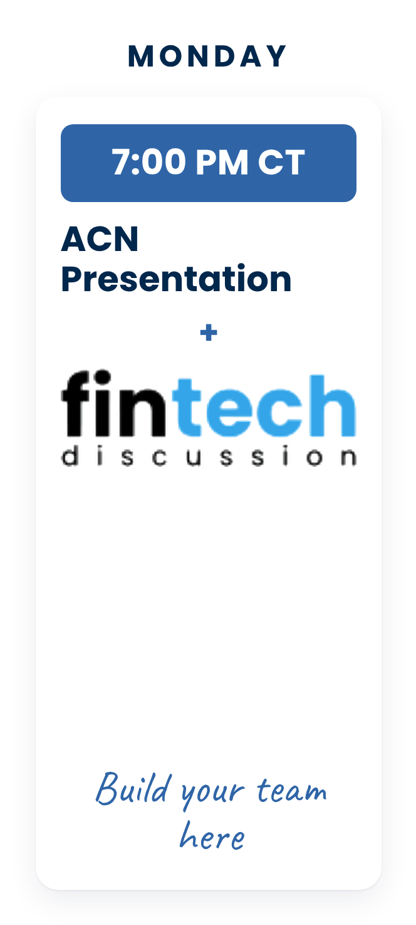
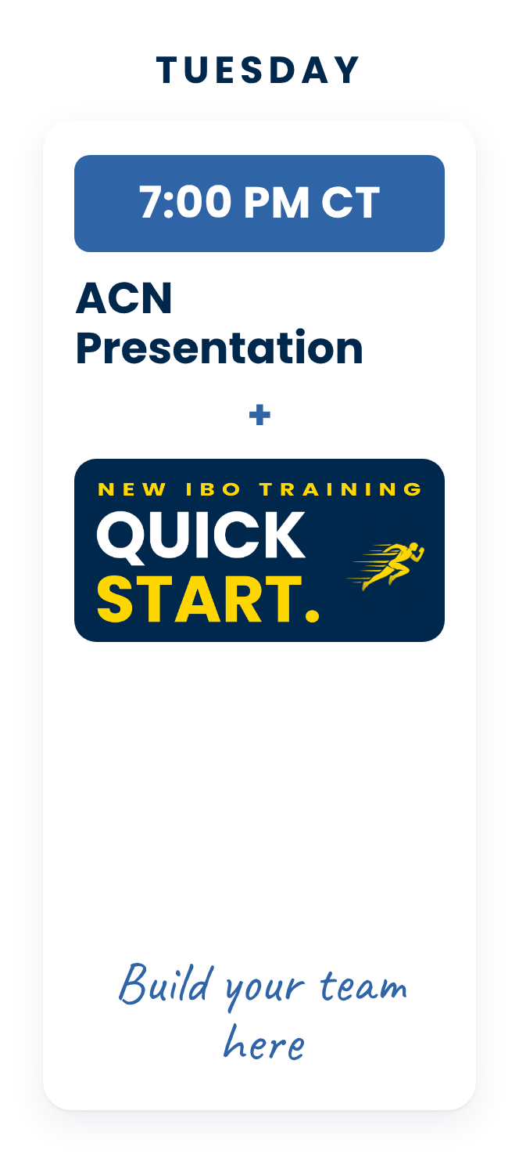
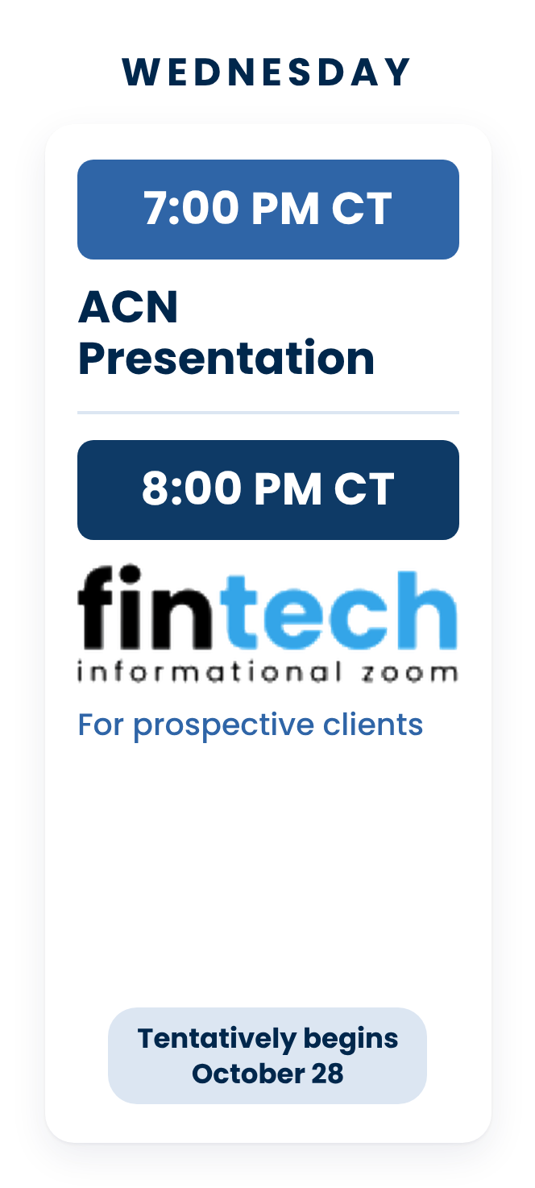
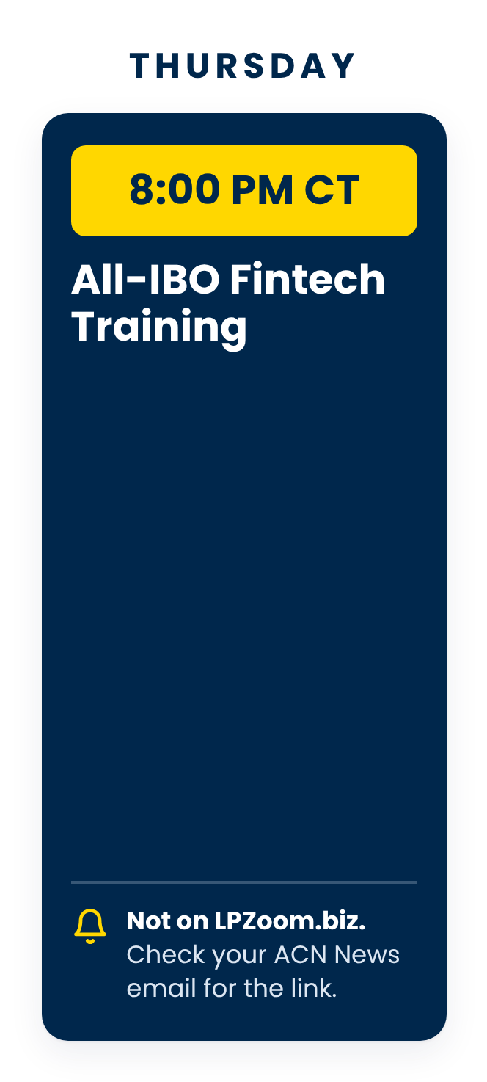
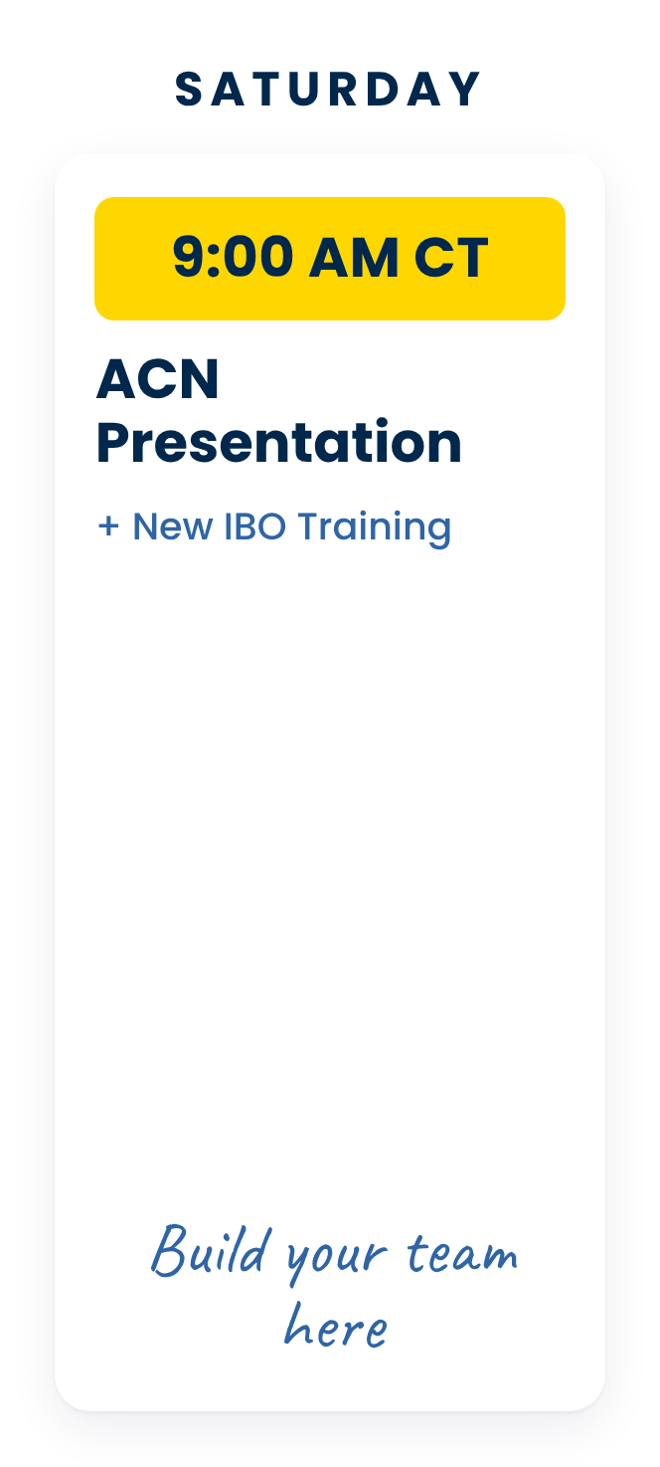

Notes:
Our team, Legacy Partners, is here to support you with virtual presentation and trainings 6 days a week.
Feel free to join us during any of these events and guests are always welcome to join us!
There is a business overview every day of the week, except Thursday and Friday.
On Wednesday Evenings, we have TWO events. (CLICK) A business overview at 7 p.m. CT followed by an (CLICK) Impact Informational Zoom at 8 p.m. CT which is a great event to invite your prospective Impact customers or to learn more about Impact yourself.
We have a second Impact Zoom on Thursday evening at 7:00 p.m. CT
Then finally a business presentation on Saturday Mornings at 9:00 a.m. CT followed by a deep dive into the ACN compensation plan and a training on how to get started right! (CLICK)

Slide 56
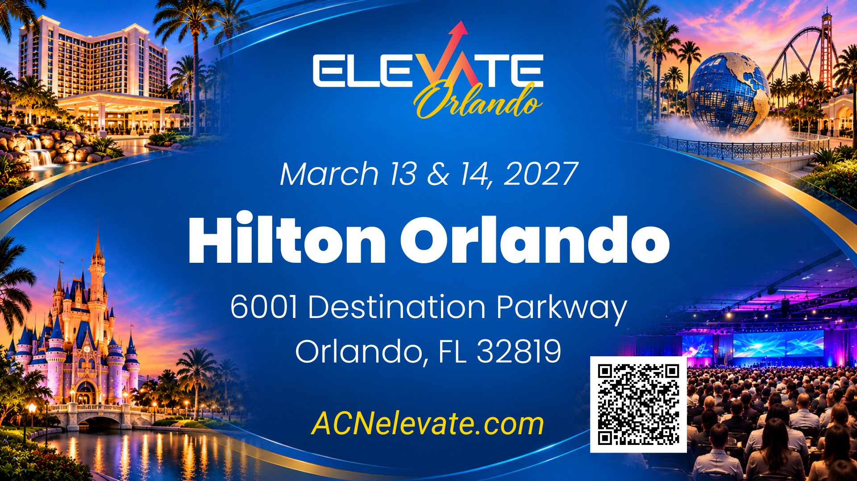
Notes:
The biggest training event of the year is coming up at the end of September in Arlington, TX.
Be there for the launch of Fintech Banking and DingoBlu and learn from the top trainers in the company exactly how you can earn with DingoBlu.
Meet the co-founders, rub shoulders with top leaders, meet the partner bank, and be ahead of the curve from the start! (CLICK)

Slide 57


