Slide 1

Compensation Plan Updates
Effective February 1, 2026

Slide 2
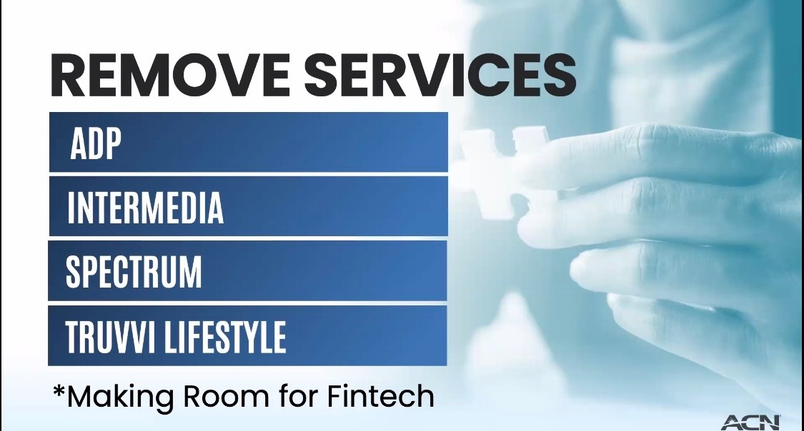

Slide 3


Slide 4
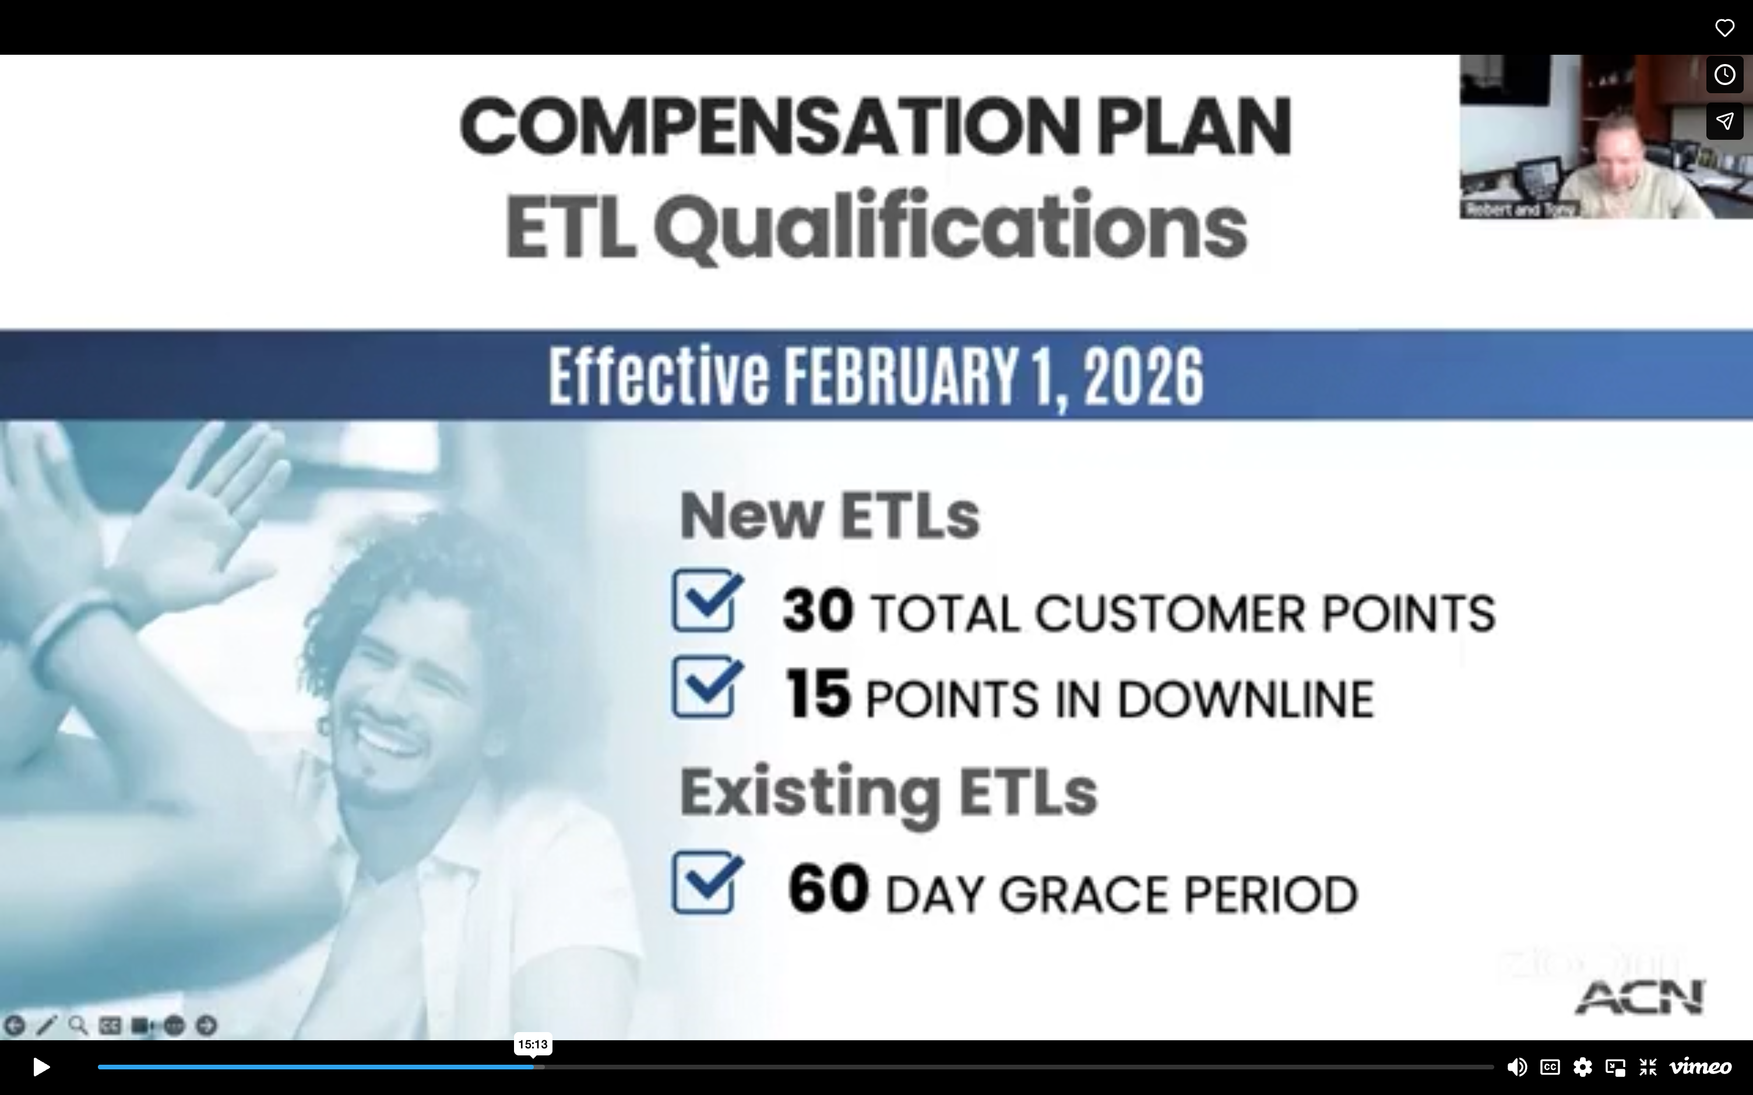

Slide 5
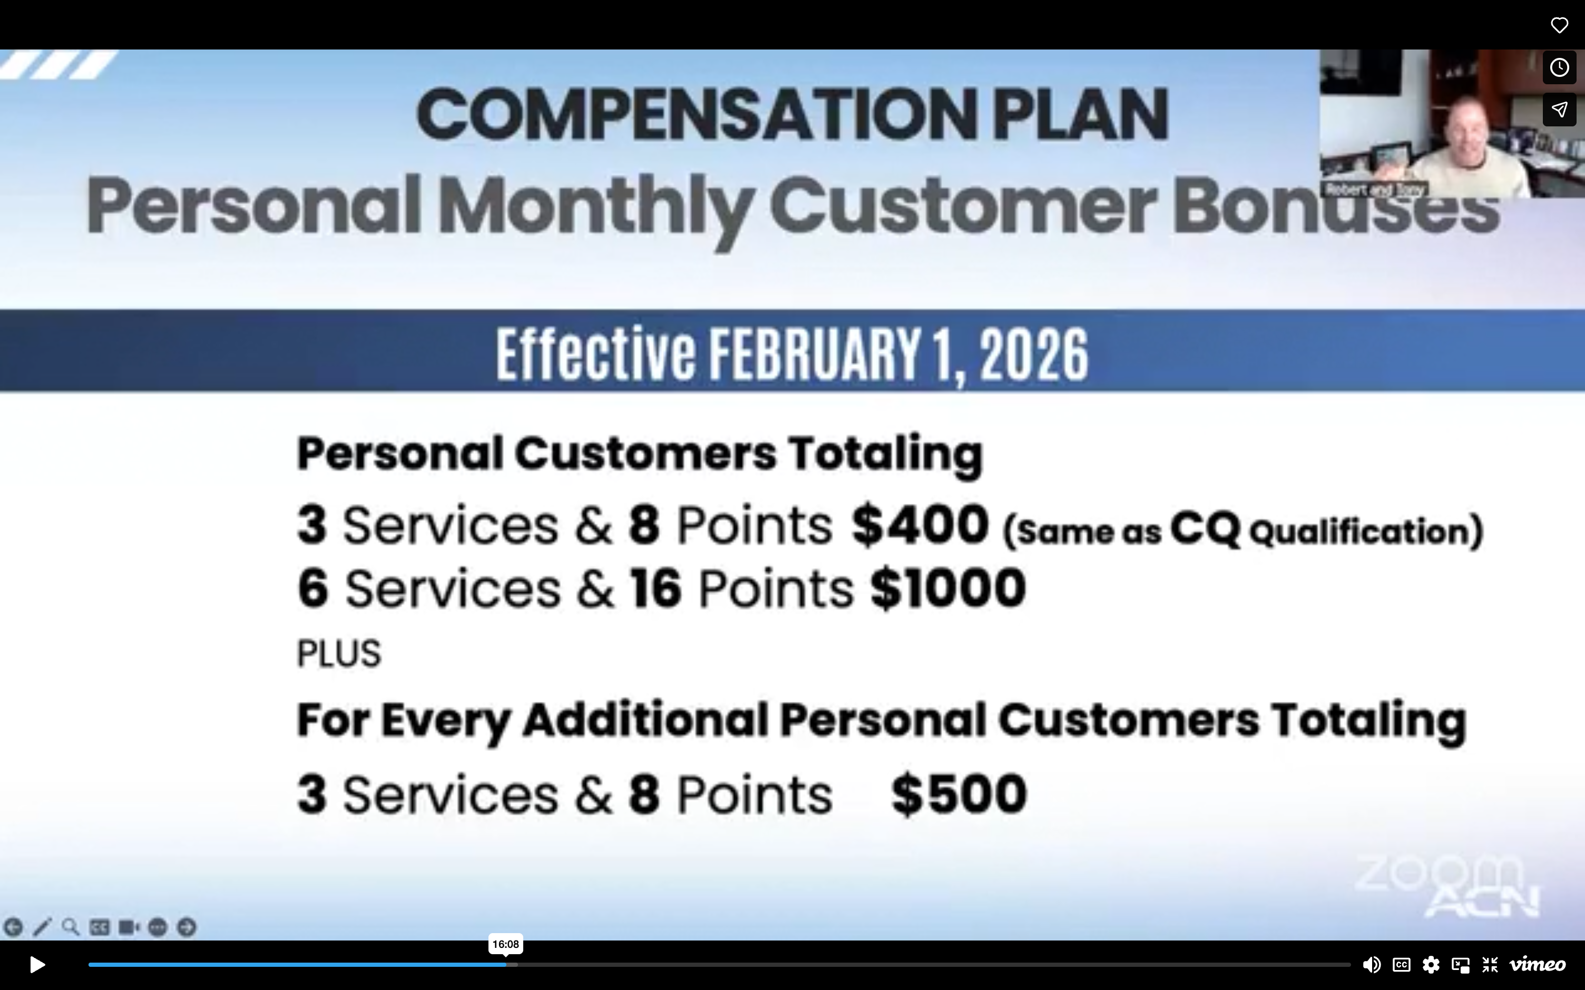

Slide 6
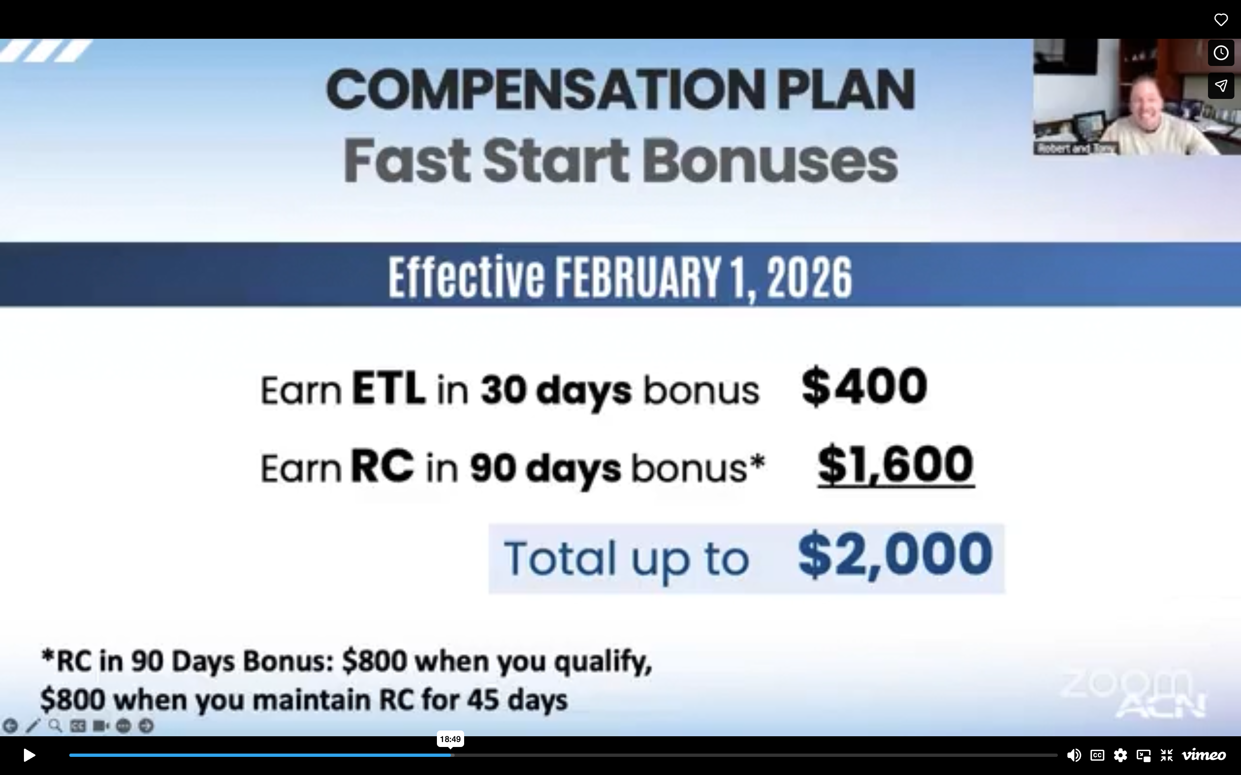

Slide 7
