Slide 1

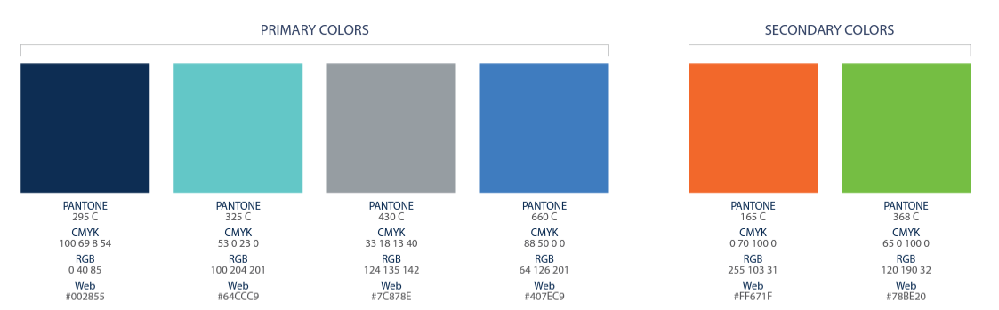
Notes:
Introduce yourself and tell your story MAX 1 minute (CLICK)

Slide 2

Consulta el Plan de Compensación de ACN y las ofertas de bonos mensuales para obtener todos los detalles. Las ganancias como IBO de ACN se basan exclusivamente en la venta exitosa de productos a los clientes y el uso que estos hagan de los productos. Las personas incurrirán en gastos en la operación de su negocio de ACN, como la Cuota de Soporte del Negocio. Al igual que con cualquier negocio, las ganancias y el éxito en ACN no están garantizados, y dependen mayormente de la perseverancia y esfuerzo individuales, así como de los resultados en la adquisición de clients personalmente o a través de su equipo. Las personas no obtendrán remuneración y perderán dinero como IBO si no se adquieren clients.
Notes:
Before we get started, I want to let you know this is a business and as with any business, if you do nothing you will earn nothing, and ACN cannot guarantee your results.
With that, let me introduce you to ACN. (CLICK)

Slide 3
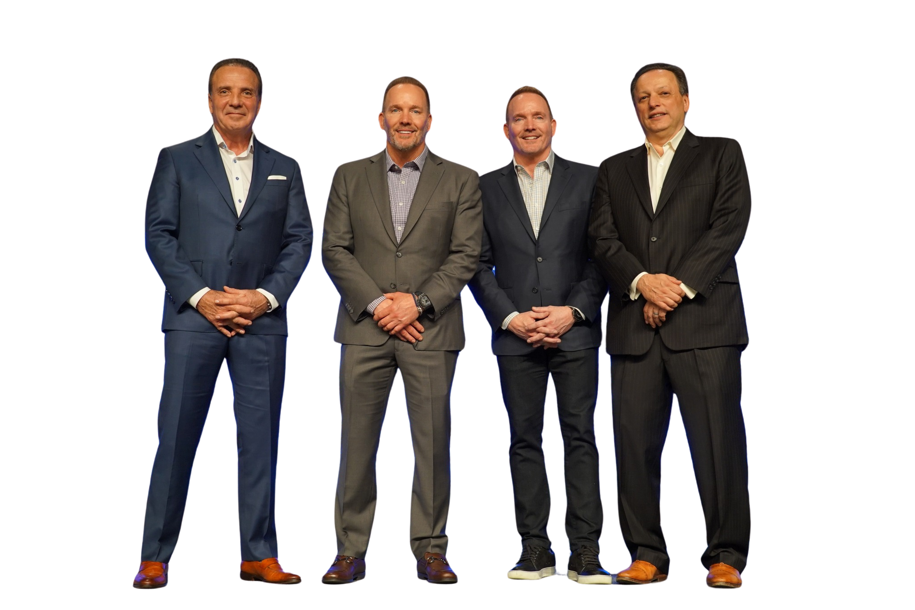




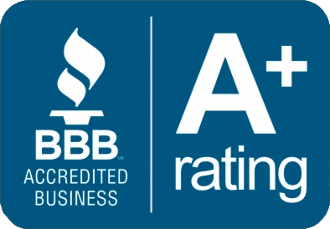






Cofundadores
Especialistas en adquisición de clientes
Fundada
en 1993
Milliones de
clientes adquiridos
Miles de Milliones
en ventes
Greg Provenzano
Tony Cupisz
Mike Cupisz
Robert Stevanovski
Notes:
ACN was founded in 1993, and today we do business all across the US & Canada. (CLICK)
In our 30+ year history, we’ve helped millions of customers with our services and have generated billions of dollars in revenue. (CLICK)
ACN has an A+ rating with the Better Business Bureau and was recognized as one of the fastest growing companies in the Inc 500. (CLICK)
ACN also has a strong tradition of giving back. Through our partnership with Project Feeding kids, a child is fed every time a customer is acquired. And ACN is also a proud supporter of the local Ronald McDonald House Charities
What does this mean to you? It means that our company has credibility...and heart...and is a company that you can count on with a proven track record of success.
So, how did ACN get started? (CLICK)

Slide 4



Aprovechando la
DESREGULACIÓN Y DISRUPCIÓN DE LA INDUSTRIA
1984
Telefonia de Larga Distacia
1990s – 2000s
Electricidad Desregulada
1996
Teléfonos Móviles Desregulados
La ruptura del monopolio de AT&T en 1984 abrió las llamadas de larga distancia a la competencia, lo que hizo bajar los precios y desató una ola de innovación en las telecomunicaciones.
La desregulación energética rompió los monopolios estatales y abrió la generación eléctrica a la competencia, dando a los consumidores más opciones y transformando los precios.
La ruptura de AT&T y la apertura del espectro inalámbrico a la competencia convirtieron el móvil de un lujo controlado por pocas operadoras en una industria masiva y asequible.
Notes:
Since the 80s numerous industries have been deregulated, beginning with long distance and continuing with Energy and Wireless with many more to follow.
Deregulation causes disruption, which in turn creates an opportunity for others break into that market.
So, in 1993 when ACN got started , they took advantage of industry disruption to create opportunity for all us in the form of residual income. (CLICK)

Slide 5
INGRESOS RESIDUALES
ingresseeeeeeeee
noun
re·sid·u·al in·come | \ ri-ˈzi-jə-wəl ˈin-ˌkəm \
Definition:
Dinero que sigues ganando mes tras mes por algo que hiciste una sola vez.
Example:
"Writing and recording a hit song that keeps selling each month is a form of residual income—you did the work once, but the money keeps coming in."
Ingresos residuales
sustantivo
in·gre·so re·si·du·al | \ in-ˈgre-so re-si-ˈdwal \
Definición:
Dinero que sigues ganando mes tras mes por algo que hiciste una sola vez.
Ejemplo:
" Escribir y grabar una canción exitosa que se siga vendiendo cada mes es una forma de ingreso residual: hiciste el trabajo una vez, pero el dinero sigue llegando.."
Notes:
When residual income is part of your financial portfolio, you continue to earn month after month on something you did only one time.
In fact, Residual income is the kind of income that the wealthiest people in the world use to leverage themselves so they can build wealth.
Here's what that looks like with ACN (CLICK)

Slide 6

OPORTUNIDADES PARA TI
Cobertura de salud
Protección contra el robo de identidad
Móvil
Tu
Televisión
Energia
Seguridad y automatización
del hogar
Procesamiento de tarjetas de crédito
Internet
¡Banca Digital!
Notes:
You have the opportunity to earn income monthly on the services that people use in their home and business every day and pay for every month.
Services like Mobile phones, Energy, Healthcare, TV, Internet and more.
Services we can't live without.
So, let's take a look at those services and also take a peek into what's coming later in 2026 as ACN continues to grow and expand its' suite of services. (CLICK)

Slide 7







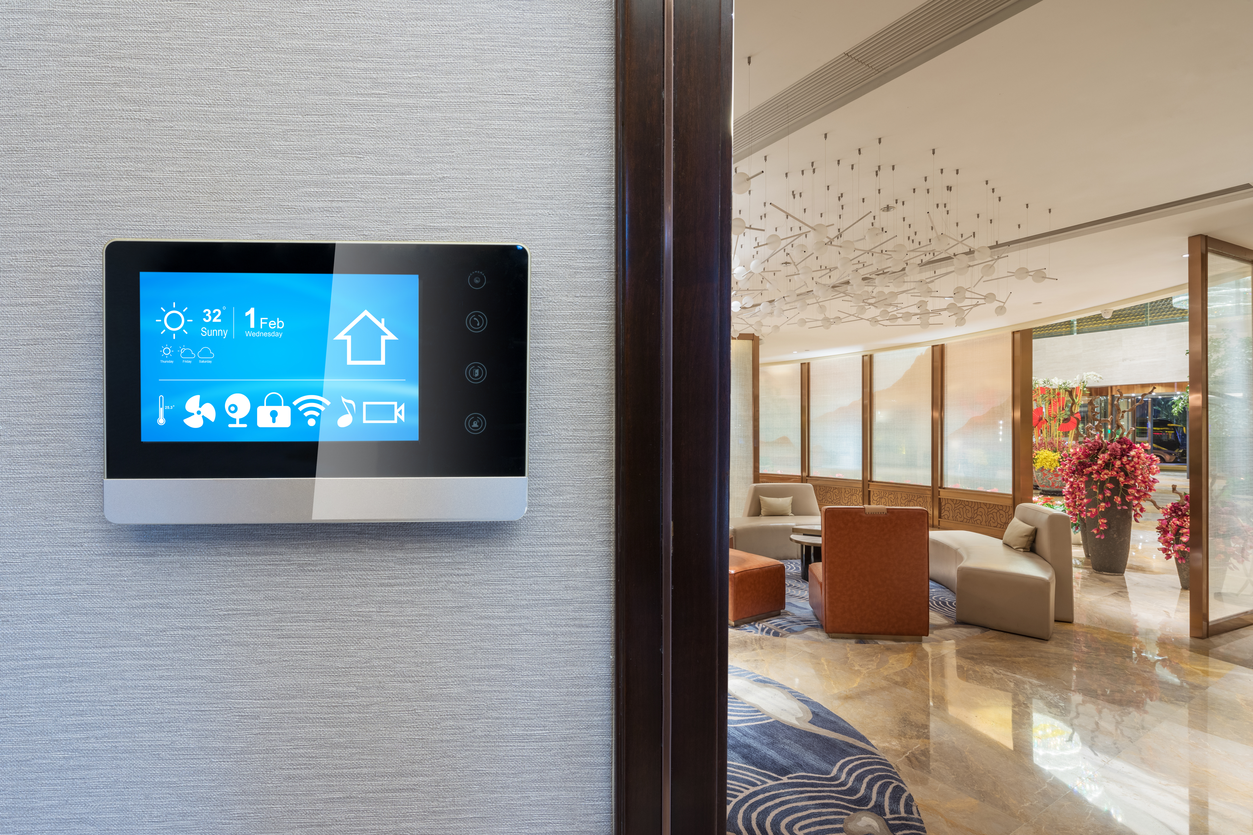











Servicios Comerciales
Notes:
Flash Mobile is ACNs signature mobile phone service - if you are like most people, you don't leave home without your phone and our lives are continually more dependent on our devices. (CLICK)
ID Theft protection with IDSeal, to keep your online life, financial life, social media and family protected from fraud on the dark web and beyond. (CLICK)
What would our lives be like without energy? We unconsciously use it every day and XOOM energy is always there when we need it! (CLICK)
With Impact Health Sharing we are helping people save on average $500/month on their current premium while lowering their deductible and offering a higher level of service. (CLICK)
When it comes to home security and automation, ACN has partnered with the Gold standard in the industry. You can guard your home while you sleep and while you are away and keep your home & family safe 24/7 with Vivint Home Security and Automation. (CLICK)
AT&T and Direct TV - two household names are long-time partners with ACN for two must-have services in every home today - Internet and TV. (CLICK)
ACN also provides services for businesses. In addition to Internet, TV, Energy, Healthcare, and Security and Automation, through our partner NMI, ACN payment processing services give you the opportunity to earn each time a credit or debit card is swiped or tapped at a business. (CLICK)
And coming in 2026, the opportunity to earn through Fintech (CLICK) - Financial Technology

Slide 8


Slide 9
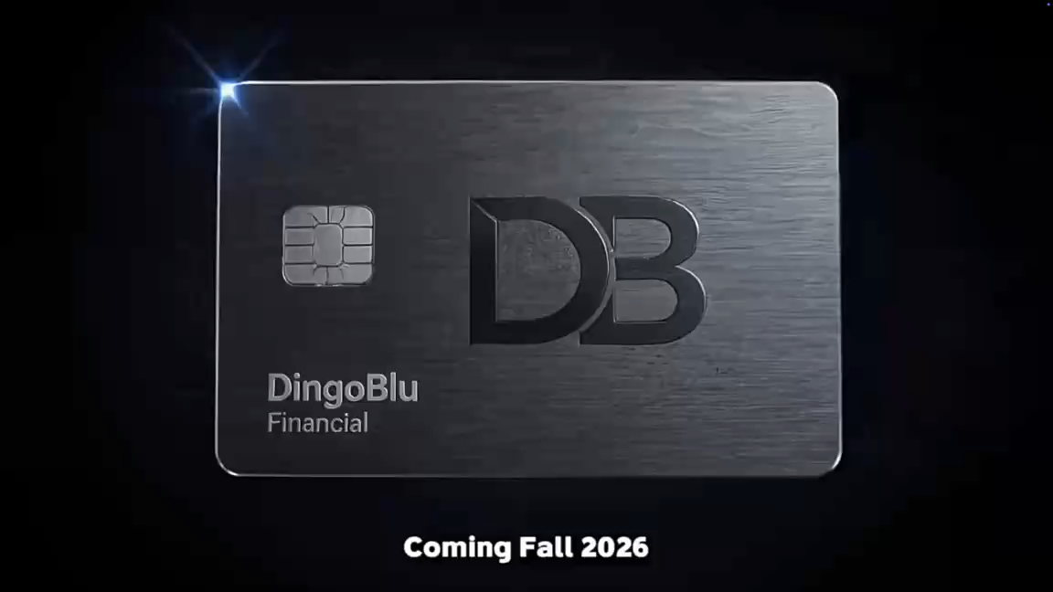

Slide 10

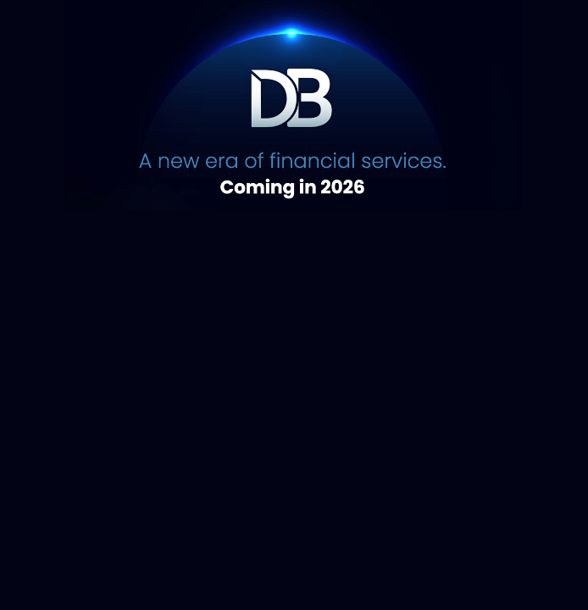
⭐️ Genera Dinero Como La Bancos⭐️
Proximente Octubre 2026
Mas Interes/Menos Cargos
Genera en Depositos y Balances en
Cuentas
Se Pagado en transacciones de CC y targetas de Debito
Expansion en el Futuro ya integrada en: Prestamos de Carros y Casas, Crypto Wallet, inversiones,
Planificacion Familiar, Planes de Retiro.
Notes:
For Customers, DingoBlu offers exactly what everyone wants. More Interest - Less Fees!
For you, you get more interest and less fees PLUS you can get paid on deposits, balances, Debit and CC transactions, taps & swipes.
Plus, future expansion is already built in! Investing, Loans, Mortgages, Family Planning, Home & Auto Loans, Crypto Wallets and more,
Now that you understand our services, let's get into how ACN goes to market and how you can earn with ACN (CLICK)

Slide 11






TRADITIONAL
BUSINESS MODEL
La mayoría de
proveedores
Medios y
Marketing digital
Oportunidad de
Ingresos para usted
Mas opciones para
los consumidores
Notes:
Most service providers create online ads, radio ads, tv ads, and pay high priced celebrities to promote their product in hope of getting customers.
ACN uses the most effective form of advertising there is - Word - Of - Mouth
A friend telling a friend. (CLICK)
So rather than paying for high priced ads or celebrities, ACN inserts YOU into the equation.
When you bring customers to ACN, giving them more choices, ACN pays you! (CLICK)

Slide 12
Notes:
There are 4 ways to earn with ACN (CLICK)

Slide 13
Bonos Menuales de Clientes Personales
¡Pagados semanalmente!
Servicios
Total de bonificacion
$1,000
$1,500
$2,000
$2,500
$3,000
12
$400
15
18
3
6
9
+ 3
Servicios
+ 3
Servicios
+ 3
Servicios
+ 3
Servicios
+ 3
Servicios
+ 3
Servicios
$400
$600
$500
$500
$500
$500
Las inscripciones de XOOM Multilocation y las inscripciones grupales de Impact Health Sharing no cuentan para este programa de bonos.
Notes:
The first way you can earn, is with up-front bonuses
When you enroll just 3 services in your first 30 days. ACN will send you a $400 Bonus!
Enroll more services and you can earn more bonuses.
When you enroll just 3 more services in your first 30 days (CLICK) ACN will send you an additional $600 bonus for a total of $1,000.
(CLICK a total of 4 times as you say the next sentence) - And each time you enroll 3 more services in your first 30 days, ACN will send you an additional $500 bonus. (CLICK)

Slide 14

Residual mensual de clientes adquiridos personalmente*
Gane entre un 3% y un 20% sobre los ingresos comisionables*
20%
3%
*Consulte El Plan de Compensacion Para Obtener Todos Los Detalles.
Notes:
The second way ACN compensates you is through monthly residual income you earn when your personal customers pay their bills.
You begin by earning 3% on the commissionable revenue on the first customers you enroll. (CLICK)
As you enroll more customers the percentage you earn also increases.
Once you have enrolled enough customers you will earn monthly residual income as much as 20% on the commissionable revenue from all your personal customers.
Now, what if you showed other people how they can get paid to do the same thing - and you built a team? (CLICK)

Slide 15
Notes:
JP Getty said it best, “I’d rather have 1% of the effort of 100 people than 100% of my own effort.”
This business isn’t about you going out and getting 1000’s of customers yourself. It’s about getting a handful of customers and teaching others to do the same. (CLICK)

Slide 16

Ingresos de los clientes adquiridos de su equipo*
Bonificaciones por adquisición de clientes anuladas
Se obtiene una vez, cuando su equipo se convierte en cliente calificado
CQ
ETL
RC
RD
RVP
SVP
Hasta
Hasta
Hasta
Hasta
Hasta
$50
$150
$250
$350
$400
$50
$150
$250
$350
$400
$50
$150
$250
$350
$400
$50
$150
$250
$350
$400
$50
$150
$250
$350
$400
Niveles Ilimitados
Niveles Ilimitados
Niveles Ilimitados
Niveles Ilimitados
Niveles Ilimitados
*Consulte El Plan de Compensacion Para Obtener Todos Los Detalles.
Notes:
So, let's see what's possible when you build a team... (CLICK)
As your team grows you can promote to higher ranks. And this is the third way you can earn. (CLICK)
When you promote to the first leadership position of Executive Team Leader, ETL, you will begin to earn overriding customer acquisition bouses up to $50 each time a new team member enrolls 3 new services in their first 30 days of business. (CLICK)
As you promote to higher ranks you can earn up to as much as $400 each time a new team member enrolls 3 new services in their first 30 days of business.
These bonuses go to unlimited levels. That's significant income as your build and grow your ACN business!
Remember, in order to earn that bonus, those people on your team had to enroll customers. What are those customers going to do every month? Pay their bills. And when they do, ACN will pay you an override of up to 4% on all of your team’s customers! (CLICK)

Slide 17
Oportunidad de crecimiento exponencial*
4%
¡Imagina ganar un 4% en todo tu equipo!
Tu
*The hypothetical used in this presentation are for illustrative purposes only and not meant to imply that they are typical. Success as an ACN Independent Business Owner is not guaranteed but rather influenced by an individual’s specific efforts. Not all Independent Business Owners make a profit, and no one can be guaranteed success as an ACN Independent Business Owner.
Notes:
Now imagine earning up to 4% on the commissionable revenue of all your team's customers.
(CLICK) In this example, you sponsored 4 team members who each enrolled customers.
Those team members want to do the same thing you did, build a team to create leverage. (CLICK - the animation will continue as you say the rest of the dialogue),
So, they sponsor a few, who sponsor a few, who sponsor a few...giving you the opportunity to earn income on the efforts of hundreds or potentially thousands of team members
Now THAT is significant income potential. (CLICK)

Slide 18


GANA BONOS
para cubrir tus servicios*
REFIERE A UN AMIGO
REFIERE A UN AMIGO
POWERUP
Recomiende a 5 o más clientes de Flash Mobile y obtenga una línea de servicio GRATIS**.
Inscriba y autentique a 5 o más clientes con un plan anual IDSeal y reciba un bono equivalente al costo de su servicio anual.*
Recomiende a más de 12 clientes de XOOM Energy Residencial de Gas Natural o a más de 12 clientes de XOOM Energy de Electricidad y reciba un bono equivalente al promedio de los cargos por producto básico en las facturas de sus clientes.
Recibe Recompensas Mes tras Mes al Alcanzar tus Metas de Referidos
*Consulte El Plan de Compensacion Para Obtener Todos Los Detalles.
**Excluye Taxas y Subcargos. Terminos Y condiciones Aplican.
Notes:
ACN also has a robust referral program. Refer a few friends to use our services and you have the potential to get your service for free.
Get with the person who invited you, to get more info on this valuable program. (CLICK)

Slide 19
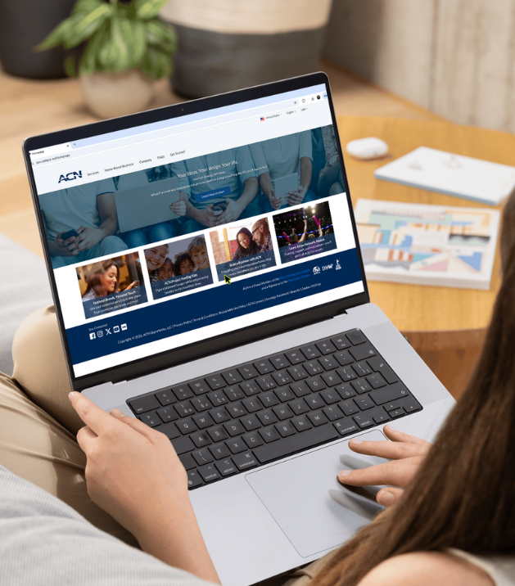






Conviertete en un empresario independiente
$299 por unica vez* + cuota de soporte del negocio de $30 por mes
Sitio web personalizado
Asistente de IA avanzado
Materiales de capacitación y marketing
Seguimiento y reports completes
Del negocio
Todo lo que se requiere es:
Soporte al cliente
Inscribir clients
Ayuda a otros a hacer lo mismo
Notes:
Now let’s look at what it takes to get started.
To become what we call an IBO, an Independent Business Owner, it’s a one-time fee of $299 and a monthly business support fee of $30. This gives you everything you’ll need to build your own successful online business.
You’ll get a personalized website or “storefront” where people can go to enroll for any of our services.
A cutting-edge AI tool that you can train to work for you.
You’ll have access to all the training, tools and support you need and will have a complete back-office reporting system to be able to track the growth of your business in real time right from your phone.
This is a low-risk, low overhead business with a substantial opportunity to earn. (CLICK)

Slide 20

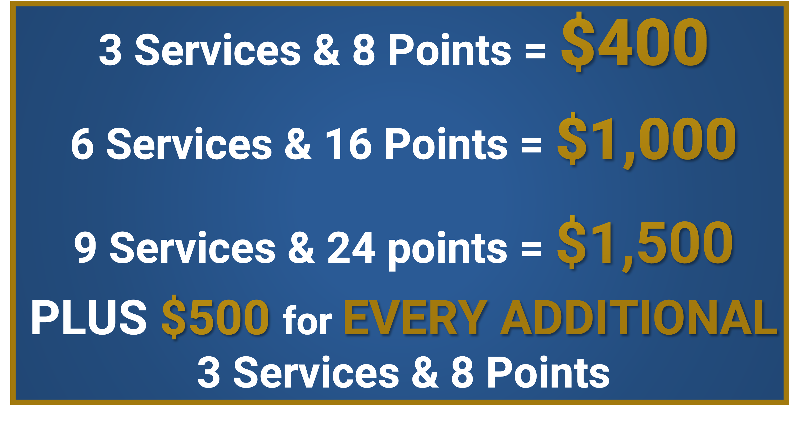
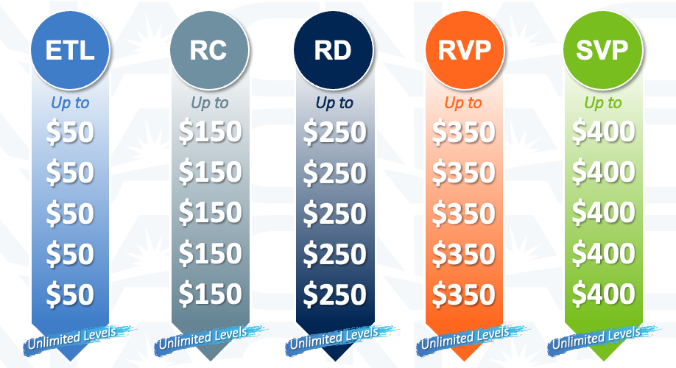




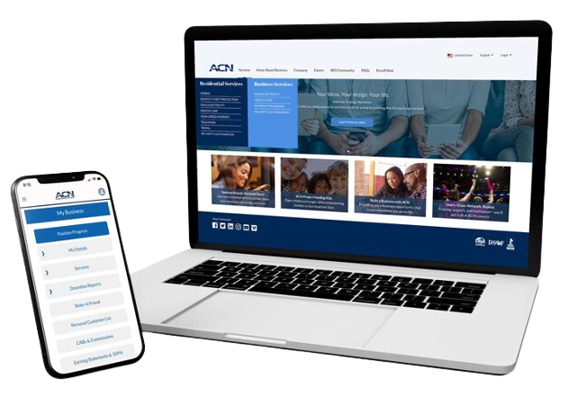
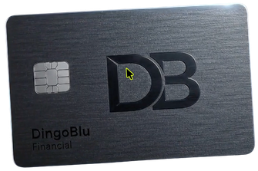
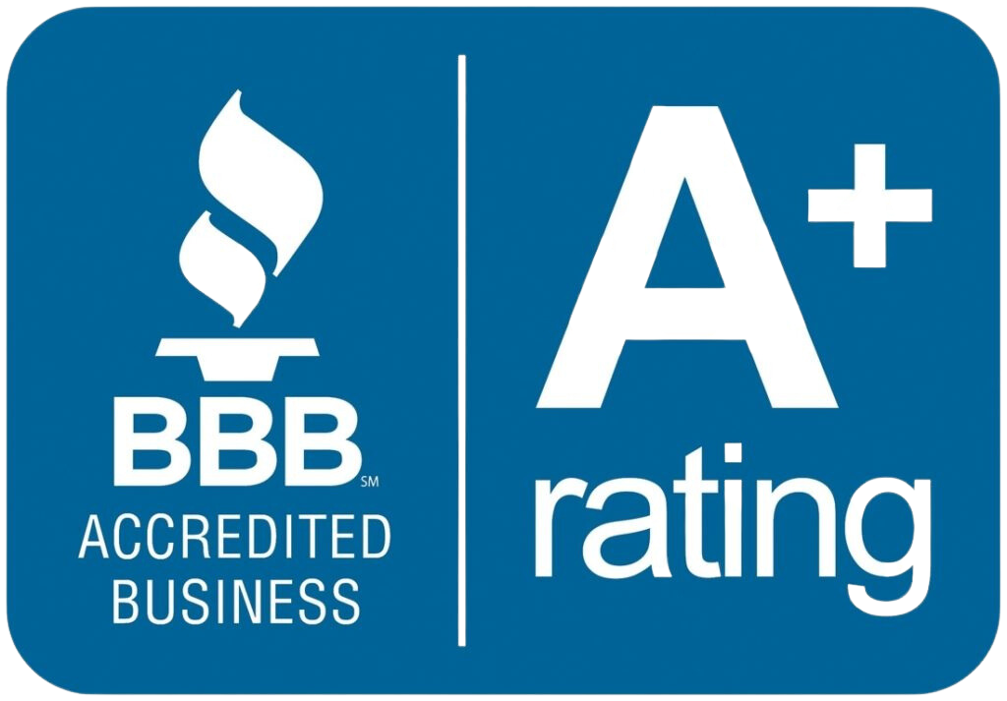

WHAT YOU GET…
Customers & IBOs
IBOs Only
¡Más Valor En servicios! | Alimenta a un niño | Obtén servicios gratis | Beneficios fiscales por ser dueño de un negocio* *Consulte siempre con su asesor fiscal
¡Gana hasta un 20% de ingresos residuales con tus clientes personales! | Ingresos residuales sobre los clientes de tu equipo Up To 4% | Gana bonos semanales | Gana bonos de equipo
Asóciate con una empresa con 33 años de trayectoria | La capacidad de manejar tu negocio desde cualquier lugar | 8 servicios para el hogar y negocios | Tecnología financiera Disponible en otoño de 2026
Established
In 1993
Notes:
Let’s review what you get.
As a customer or business partner, you get better value on services you are already using and by default you help to feed a hungry child through project feeding kids!
As a business partner...
You can take advantage of our referral program to earn free services
Get the tax benefits of business ownership
Earn Residual income on your personal customers and your team's customer
Earn bonuses from enrolling customers or when your team enroll customers.
Partner with a company that has a track record for success
Run your business from anywhere and have access to 8 residential and business services
And later this year you can take part in the Exclusive launch of Fintech Banking and build financial security for you and your family! (CLICK)

Slide 21



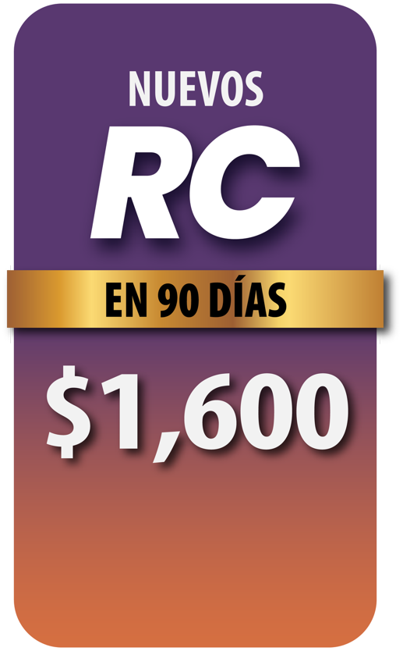


1-31 de agosto
($800 cuando cumples los requisitos y los otros $800 si sigues cumpliéndolos durante 45 días).
Califica como ETL en tus primeros 30 días con al menos 15 puntos de clientes de línea descendente.
* Consulta el Plan de compensación de ACN para conocer los detalles completos. Los clientes deben ser de Estados Unidos. Las inscripciones
de múltiples ubicaciones (MLE) de XOOM Energy y las inscripciones grupales de Impact Health Sharing no cuentan para este programa de bonificación.

Slide 22



You are 1 of 3 people
Inscríbete
y
Asiste a la capacitación
Resuelve tus dudas
y
Asiste al próximo evento
Conviértete
en
cliente
Notes:
By now you are likely one of 3 people…
You’re excited and ready to get started: If that's you, get enrolled right away and attend training! (CLICK)
Perhaps, you are interested, but you want to learn more: Get with the person who invited you to get your questions answered and then attend training, so you can get more info! (CLICK)
Perhaps, this isn’t the right time for you: Let the person who invited you know and talk with them about becoming their customer. They will appreciate it more than you know! (CLICK)

Slide 23
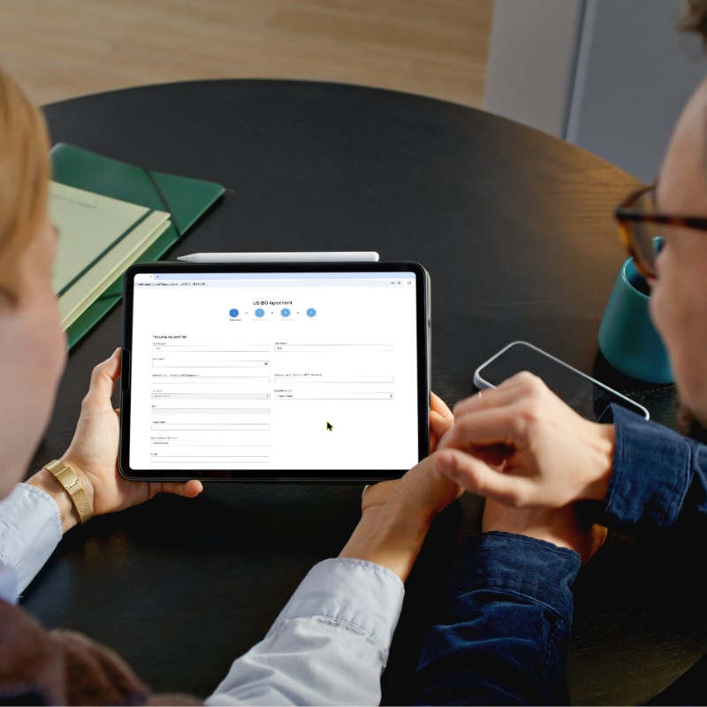

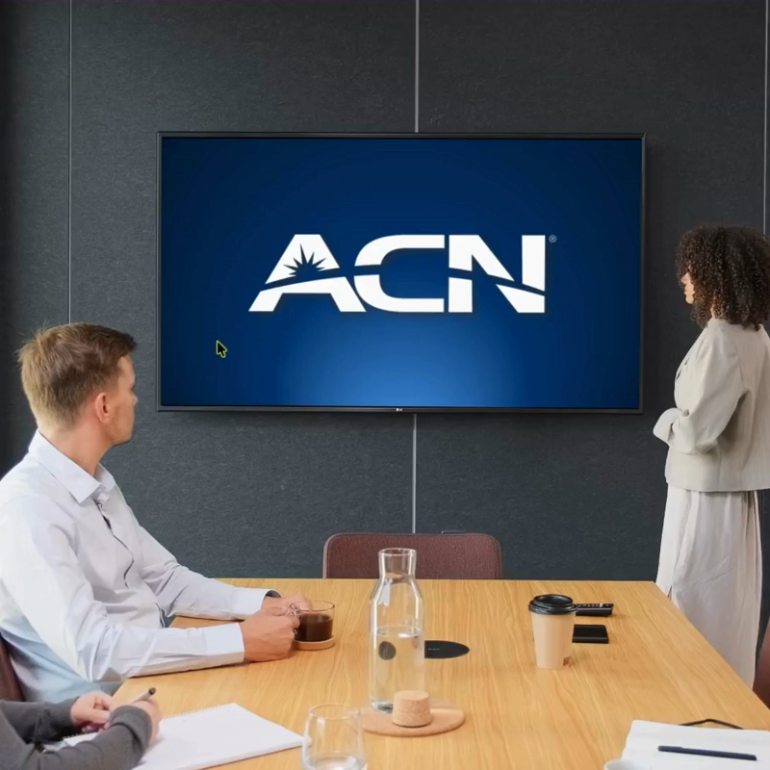
Cómo empezar a ganar dinero HOY…
1
2
3
Inscríbase
Capacitese
Construya su Negocio
Notes:
Now, if you’re like I was when I first saw this, you’re probably excited. If you’re ready to get started, get with the person who invited you, and they will help you enroll as an IBO. Remember, you’re in business for yourself but never by yourself. We have a great system in place to help you get off to a fast start, so plug into our trainings, learn the basics and start acquiring your customers and building your team. (CLICK)

Slide 24

Notes:
I want to thank you for taking the time to watch this presentation and let me be the first to welcome you to the team!

