Slide 1



x
Social Media Post Library - IBO Launch Campaign
Prepared for ACN IBOs | For Approved Use Only | Confidential

Slide 2



Compliance Rules
Read Before Posting
Only post ACN-approved content. These posts are approved for IBO use as written.
DingoBlu is a financial technology company offering banking services.* Do not refer to DingoBlu as a bank.
DingoBlu’s partner bank provides FDIC coverage on customer deposits, not DingoBlu.
Do not use logos in your posts such as the Visa Mastercard, or partner bank logos.
Do not share specific launch dates or internal timelines.
Do not modify these captions in ways that add claims not listed above.
Do not make income or lifestyle claims when promoting DingoBlu or your ACN business.
Contact ACN leadership with any questions before posting modified content.
Prepared for ACN IBOs | For Approved Use Only | Confidential
*DingoBlu is a financial technology platform, not an FDIC-Insured bank. Banking services and eligible deposit accounts will be provided by DingoBlu’s FDIC-insured partner bank. FDIC insurance is provided by such banks up to applicable limits and subject to FDIC requirements.
x

Slide 3

How to Use These Posts
These posts are designed to create awareness and excitement about DingoBlu's upcoming launch. You can post them as-is or add a personal sentence at the beginning — just don't change the core content or add claims not included here.
Pair your posts with the official DingoBlu image or video assets that ACN provides. Do not use third-party logos or create your own branded graphics without written approval.
Prepared for ACN IBOs | For Approved Use Only | Confidential
x

Slide 4
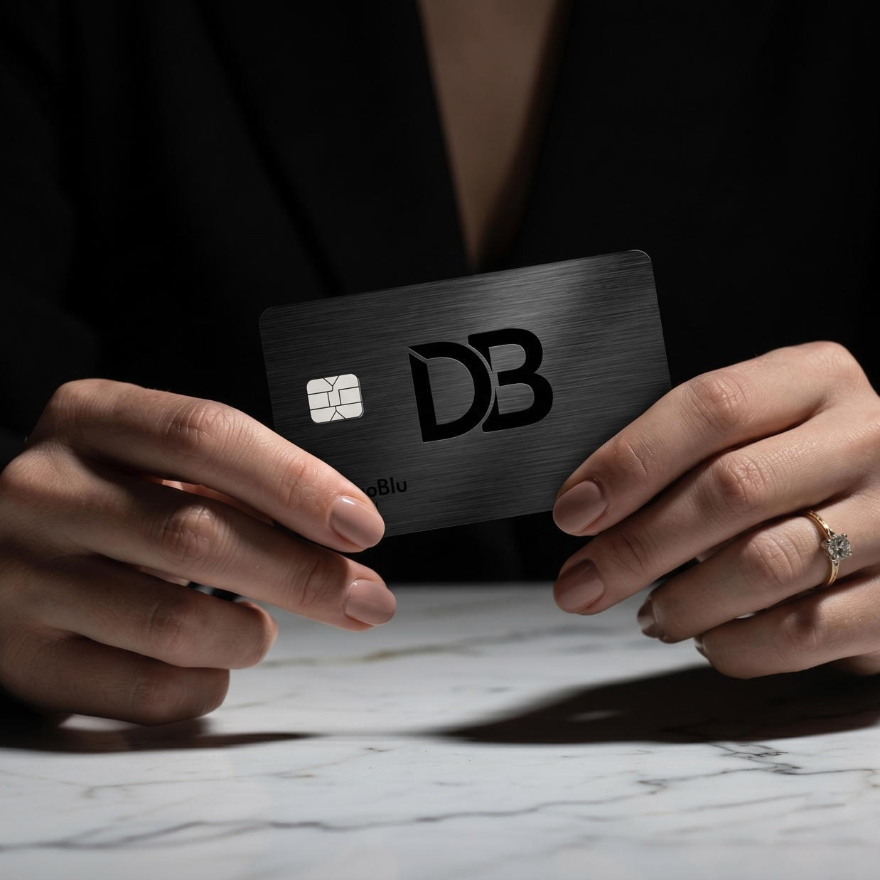

POST 01
Facebook / Instagram
Teaser — Excited, Forward-Looking
Caption:
Something big is on the way. ACN is introducing DingoBlu — a modern, mobile-first financial technology company offering banking services.* Checking accounts, savings accounts, debit cards, secured credit cards, and credit cards. Simple. Accessible. Built for everyone. Details coming soon. Stay tuned. 💙
DingoBlu is a financial technology platform, not an FDIC-Insured bank. Banking services and eligible deposit accounts will be provided by DingoBlu’s FDIC‑insured partner bank. FDIC insurance is provided by such banks up to applicable limits and subject to FDIC requirements.
#DingoBlu #ACN #FinTech #ComingSoon #MobileBanking
Prepared for ACN IBOs | For Approved Use Only | Confidential

Slide 5
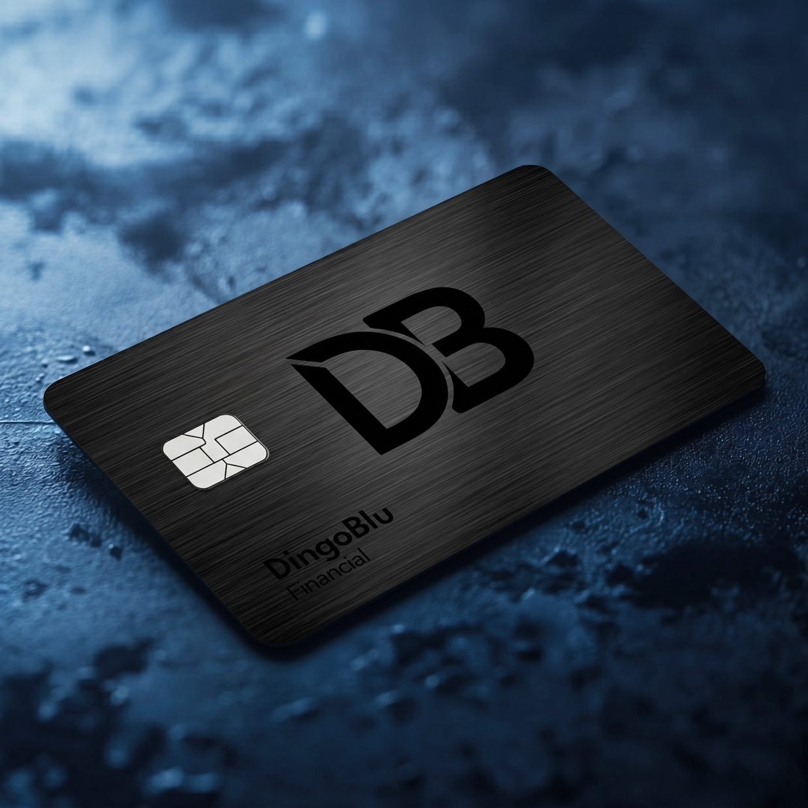
POST 01
Facebook / Instagram
Teaser — Excited, Forward-Looking
Caption:
Something big is on the way. ACN is introducing DingoBlu — a modern, mobile-first financial technology company offering banking services.* Checking accounts, savings accounts, debit cards, secured credit cards, and credit cards. Simple. Accessible. Built for everyone. Details coming soon. Stay tuned. 💙
DingoBlu is a financial technology platform, not an FDIC-Insured bank. Banking services and eligible deposit accounts will be provided by DingoBlu’s FDIC‑insured partner bank. FDIC insurance is provided by such banks up to applicable limits and subject to FDIC requirements.
#DingoBlu #ACN #FinTech #ComingSoon #MobileBanking
Prepared for ACN IBOs | For Approved Use Only | Confidential

Slide 6

POST 02
Facebook / LinkedIn Professional — Opportunity Focus
Caption:
$16.6 trillion.
That's how much Americans are holding in deposits and savings accounts right now.
With DingoBlu, you earn a percentage
of your customers' balances every single month
— just for having their money sit in an account.
Not a one-time commission. Every month.
For the life of the customer.
DingoBlu is a financial technology platform, not an FDIC-Insured bank. Banking services and eligible deposit accounts will be provided by DingoBlu’s FDIC‑insured partner bank. FDIC insurance is provided by such banks up to applicable limits and subject to FDIC requirements.
#DingoBlu #ACN #DirectSales #FinTech #Innovation
*Source: Federal Reserve, Oct 2025 Money Stock Measures, H.6 Release
Prepared for ACN IBOs | For Approved Use Only | Confidential

Slide 7
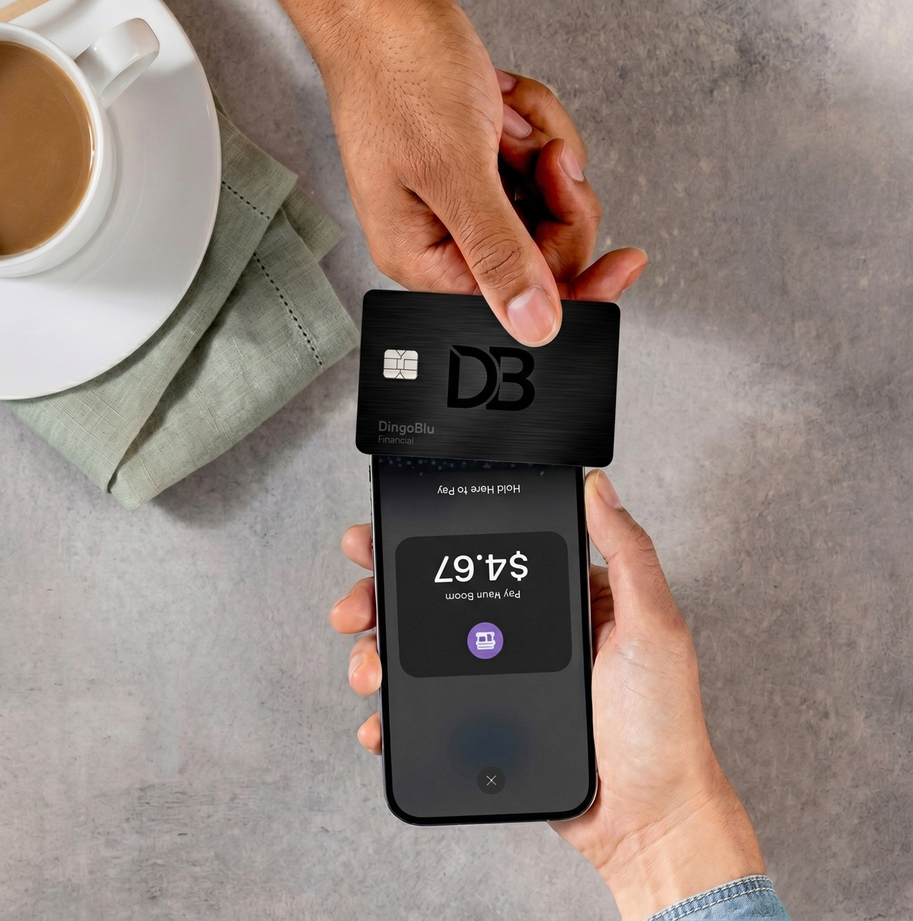
POST 03
Instagram
Casual — Personal Voice
Caption:
Coffee ☕ — you earn.
Gas ⛽ — you earn.
Groceries 🛒 — you earn.
Every time your DingoBlu customer taps their card, a percentage comes back to you.
Sign them up once. Get paid every time
they spend.
DingoBlu is a financial technology platform, not an FDIC-Insured bank. Banking services and eligible deposit accounts will be provided by DingoBlu’s FDIC‑insured partner bank. FDIC insurance is provided by such banks up to applicable limits and subject to FDIC requirements.
#DingoBlu #ACN #FinTech #MobileBanking #ComingSoon
Prepared for ACN IBOs | For Approved Use Only | Confidential

Slide 8

POST 04
Facebook / Instagram
Consumer-Focused — Value Prop
Caption:
Netflix. Electric bill. Car insurance. Spotify. Amazon.
Your customers are already paying these every single month — automatically, without thinking about it.
With DingoBlu, every one of those transactions can earn you a percentage. Same bills. Same subscriptions. Same spending. Just now it pays you too.
DingoBlu is a financial technology platform, not an FDIC-Insured bank. Banking services and eligible deposit accounts will be provided by DingoBlu’s FDIC‑insured partner bank. FDIC insurance is provided by such banks up to applicable limits and subject to FDIC requirements.
#DingoBlu #ACN #FinancialServices #FinTech #AccessForAll
Prepared for ACN IBOs | For Approved Use Only | Confidential

Slide 9

POST 04
POST 04
Facebook / Instagram
Consumer-Focused — Value Prop
Caption:
Netflix. Electric bill. Car insurance. Spotify. Amazon.
Your customers are already paying these every single month — automatically, without thinking about it.
With DingoBlu, every one of those transactions can earn you a percentage. Same bills. Same subscriptions. Same spending. Just now it pays you too.
DingoBlu is a financial technology platform, not an FDIC-Insured bank. Banking services and eligible deposit accounts will be provided by DingoBlu’s FDIC‑insured partner bank. FDIC insurance is provided by such banks up to applicable limits and subject to FDIC requirements.
#DingoBlu #ACN #FinancialServices #FinTech #AccessForAll
Prepared for ACN IBOs | For Approved Use Only | Confidential

Slide 10
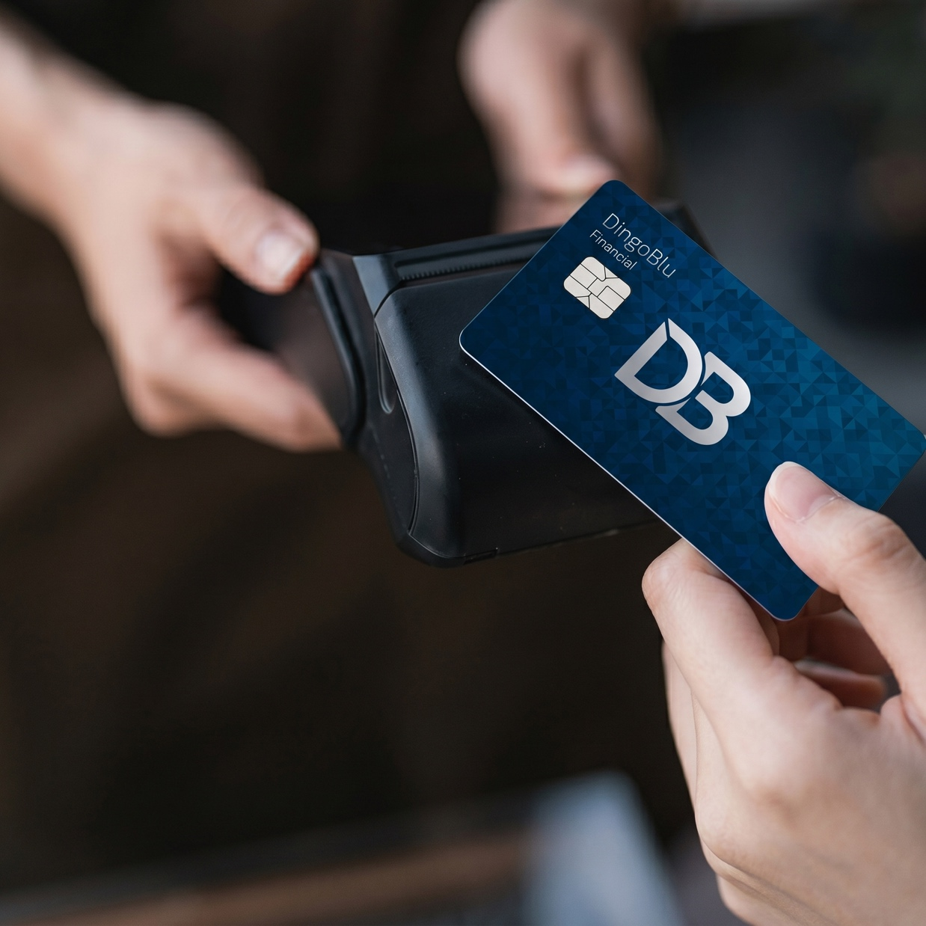
POST 05
Instagram / Facebook
Countdown / Urgency
Caption:
Most commissions happen once.
With DingoBlu, every time your customer buys a coffee, pays for gas, or shops online — you can earn a percentage of that transaction.
They live their life. You get paid for it
DingoBlu is a financial technology platform, not an FDIC-Insured bank. Banking services and eligible deposit accounts will be provided by DingoBlu’s FDIC‑insured partner bank. FDIC insurance is provided by such banks up to applicable limits and subject to FDIC requirements.
#DingoBlu #ACN #LaunchingSoon #FinTech #MobileBanking
Prepared for ACN IBOs | For Approved Use Only | Confidential

Slide 11
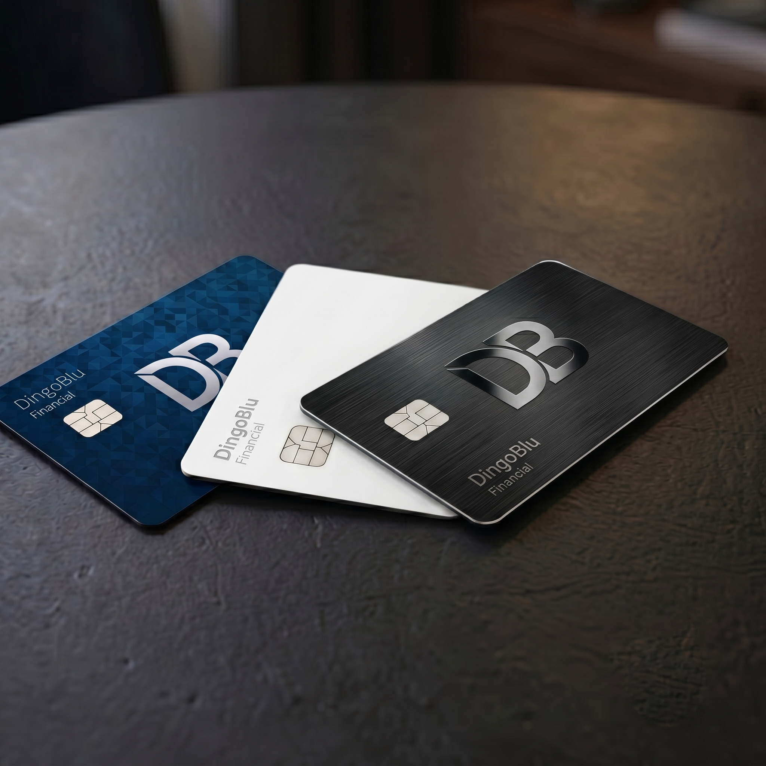
POST 06
LinkedIn
Thought Leadership — Industry Angle
Caption:
The average American pays 7–8 subscriptions a month.
Add utilities, insurance, groceries, and online shopping, and you're looking at dozens of transactions, every single month, like clockwork.
With DingoBlu, every one of those can earn you a percentage. Multiply that across a growing customer base and the math gets interesting fast.
DingoBlu is a financial technology platform, not an FDIC-Insured bank. Banking services and eligible deposit accounts will be provided by DingoBlu’s FDIC‑insured partner bank. FDIC insurance is provided by such banks up to applicable limits and subject to FDIC requirements.
#DingoBlu #ACN #FinTech #DirectSales #FutureOfBanking
Prepared for ACN IBOs | For Approved Use Only | Confidential

