Slide 1





Slide 2
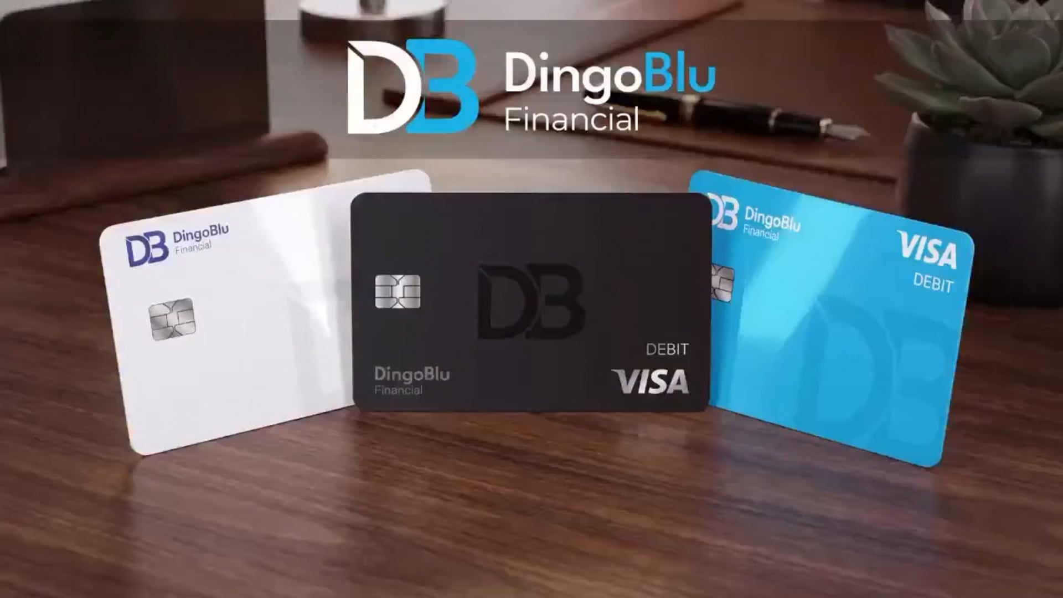

Slide 3

Today isn't about introducing another checking or savings account.
We're not trying to become the biggest financial institution.
We're trying to become the most valuable financial relationship our clients have.

Slide 4

WHAT IT IS
MVB Bank
Partner
Visa Fintech
Partner
Fintech Banking
Think Chime and SoFi

Slide 5

Who Is DingoBlu Built For?
THE PEOPLE WE SERVE
✕
Not the Wealthiest Americans
They already have…
Private Banking
Instead…
Wealth Advisors
DingoBlu was built for hardworking Americans who deserve more value from everyday banking.
Dedicated Relationship Managers

Slide 6
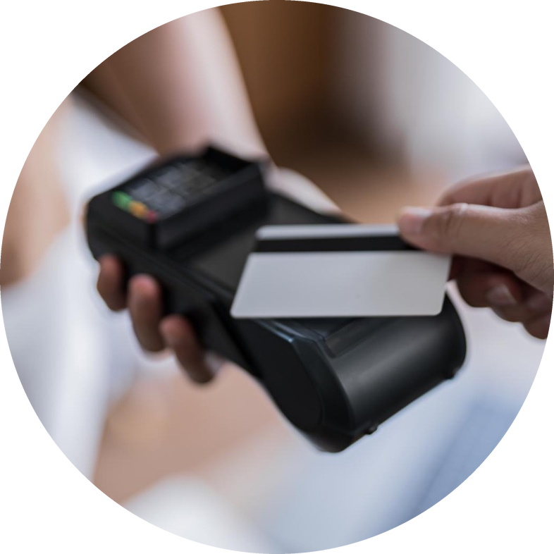
People Do 2 Things With Money
They Save It
They Spend It
How would you like to get paid on both?

Slide 7
SAVE MONEY
Americans Have Entrusted Banks With
$14.76
TRILLION
in Checking & Savings Deposits*
*Source: Federal Reserve Board, Money Stock Measures, H.6 Release, October 28, 2025, Table 2, “Seasonally Adjusted Components of M1 and Non-M1 M2.” Federal Reserve H.6 release, October 28, 2025

Slide 8
Target Market
SAVE MONEY
80%
$8,000
of American households have less than $20,000 in savings.
is the median checking and savings balance in America.
You get paid every month on their Average Daily Balance (ADB)
Source: Federal Reserve Survey of Consumers 2022
Notes:
You get paid every month on their ADB (Average Daily Balance).

Slide 9
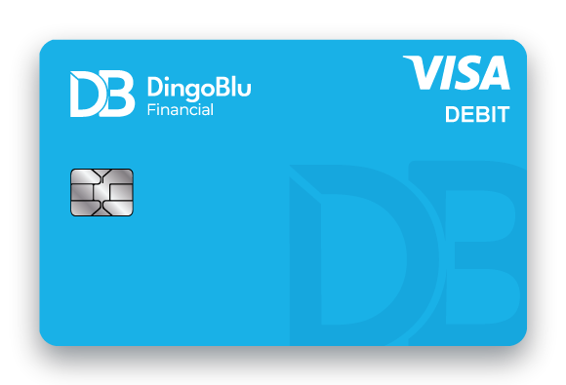
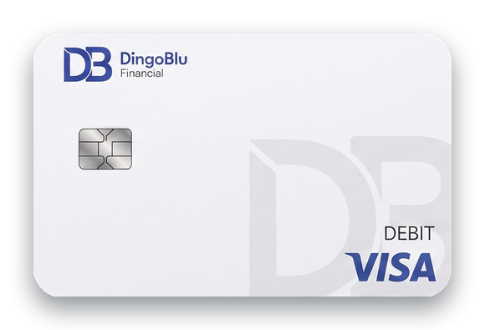
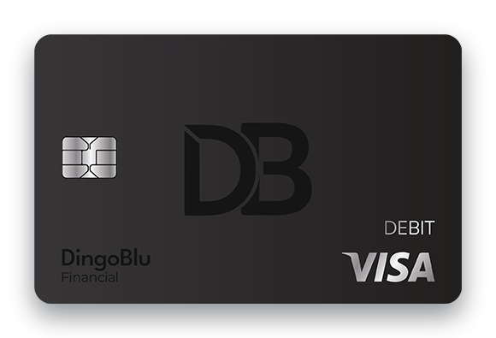
Target Market
SPEND MONEY
35 /mo
85%
times the average person uses their card*
of adults have a debit card**
You get paid on every debit card transaction.
*Pulse Debit Issuer Study (2025) **Federal Reserve Survey of Consumers 2022 ***Credit cards coming in 2027

Slide 10

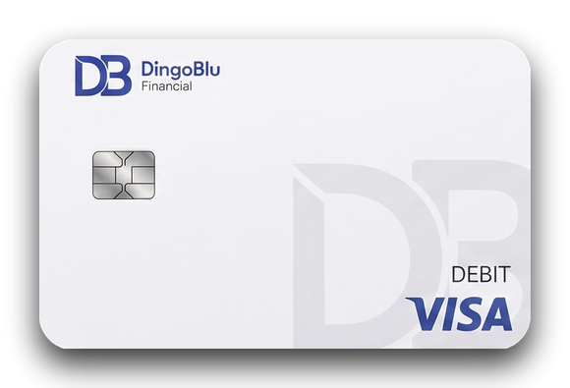
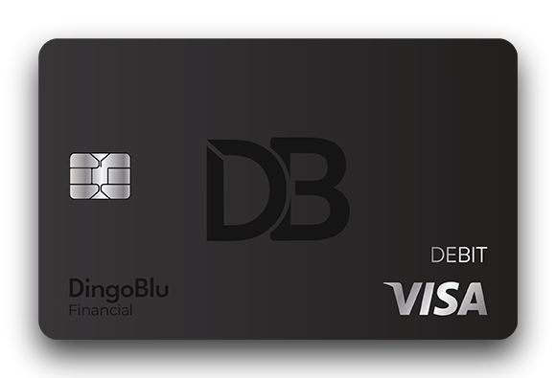
Three Accounts. One Philosophy.
Helping clients get more from their money.
Advantage
Premier
Signature

Slide 11
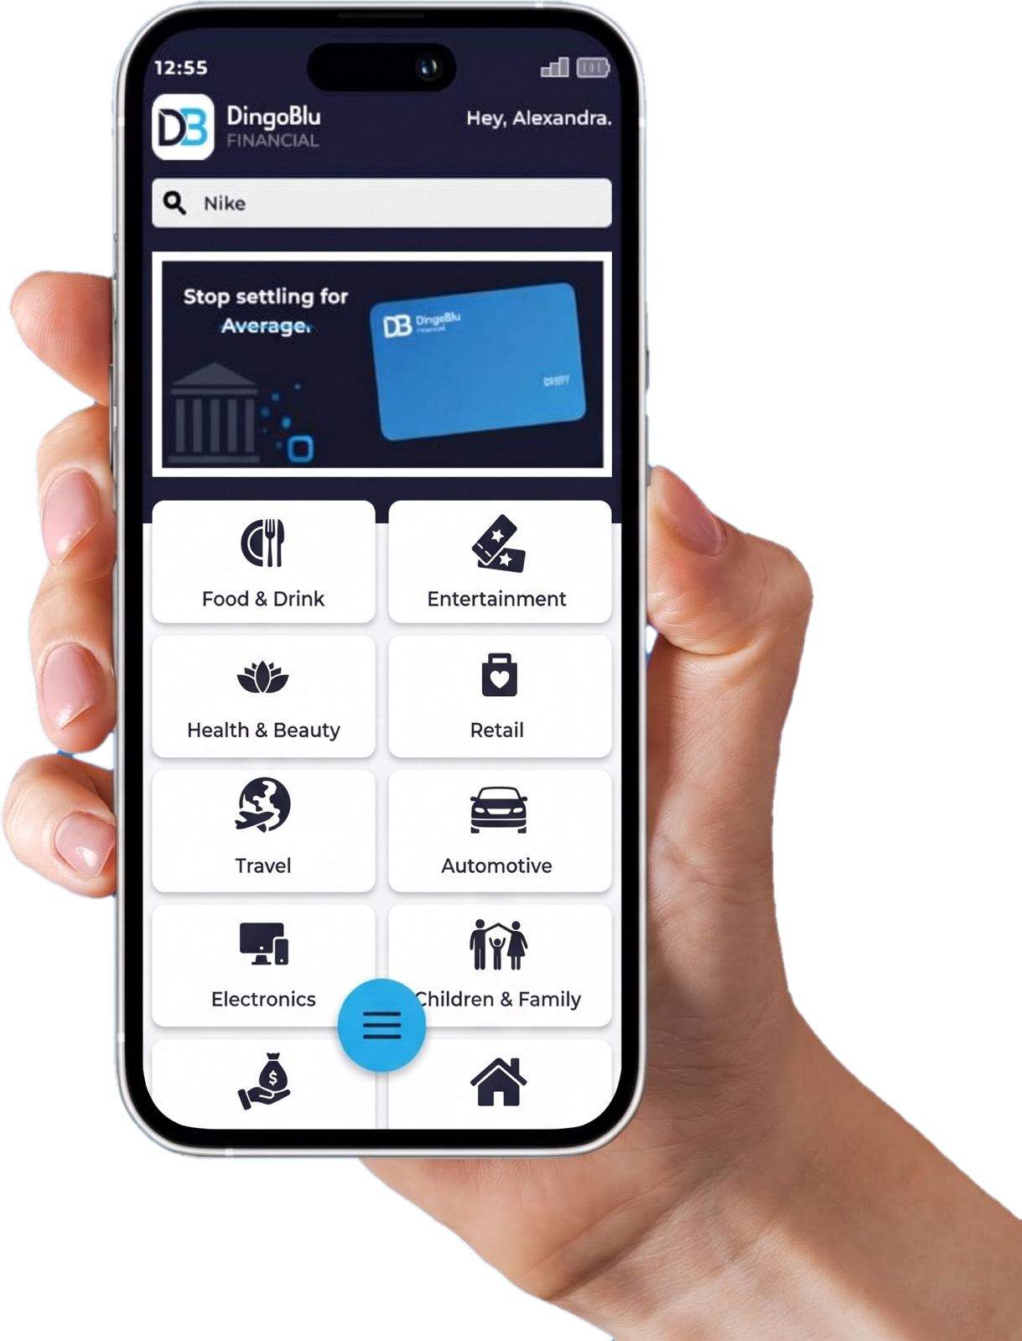
THE DINGOBLU APP
Cash Back
Rewards App

Slide 12
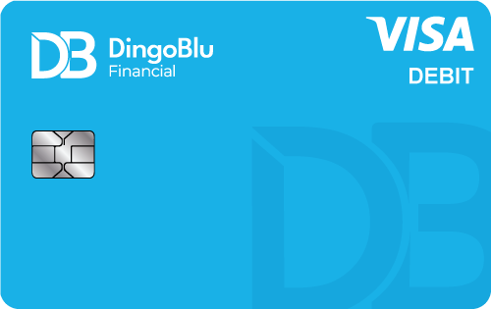
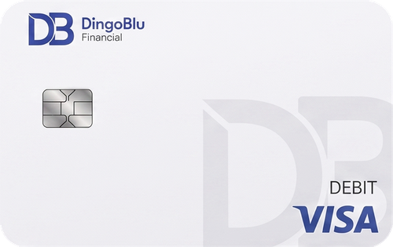
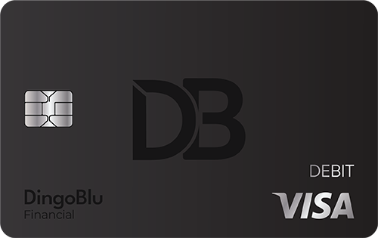




Discount Platform Plus Cash Back
LOYALTY AND REWARDS
Advantage
Premier
Signature
Cash Back Travel for All Hotels
Cash Back Rental Cars
Cash Back Food Delivery for DoorDash / Uber Eats
*
**
Cash Back Fuel
***
*Maximum $8 per month **Maximum $10 per month ***Maximum $25 per month

Slide 13






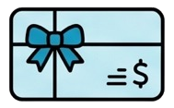

Cash Back App for Everyday Spending
LOYALTY AND REWARDS
Food & Drink
Retail
Health & Beauty
Home & Garden
Automotive
Children & Family
Gift Cards
Entertainment

Slide 14

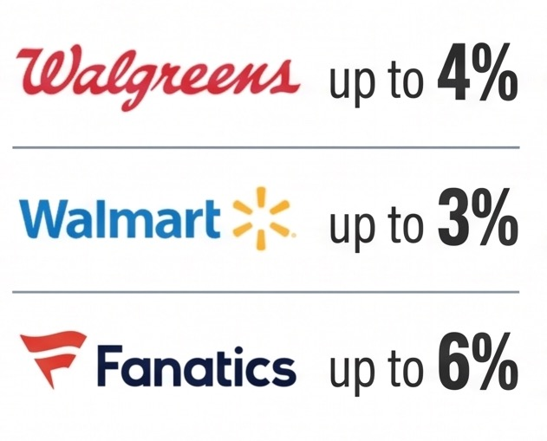
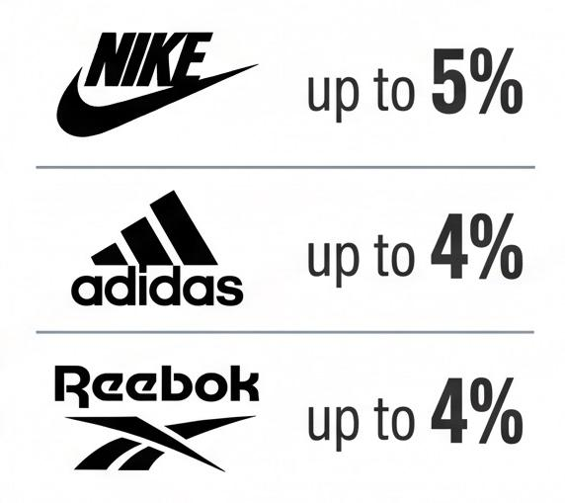
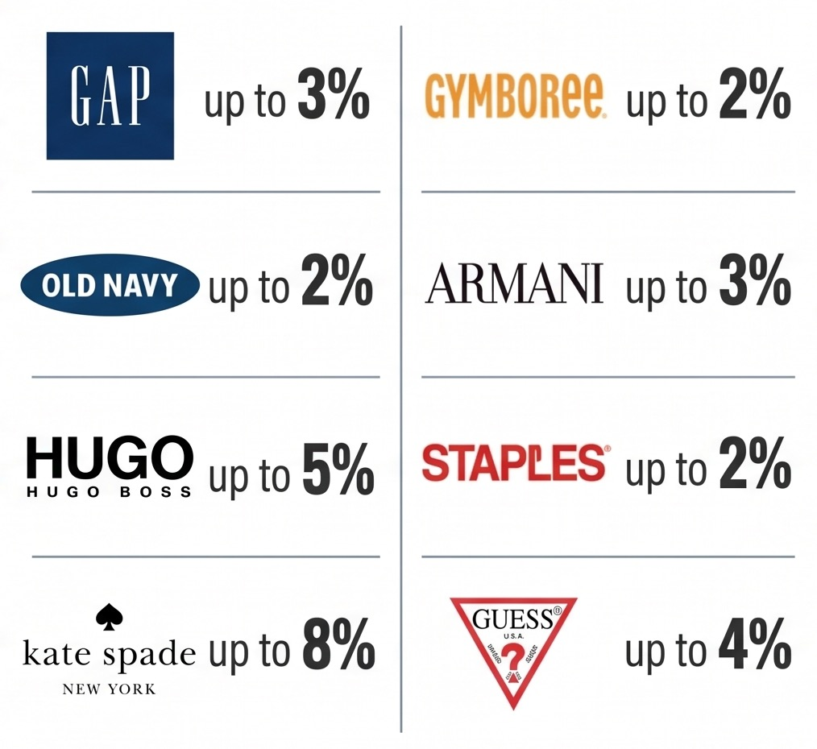
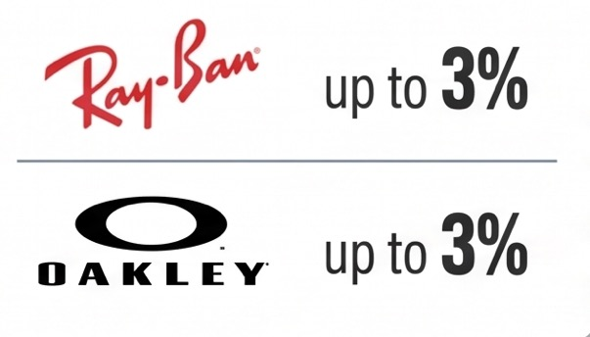
Thousands of Retailers
ONLINE SHOPPING

Slide 15


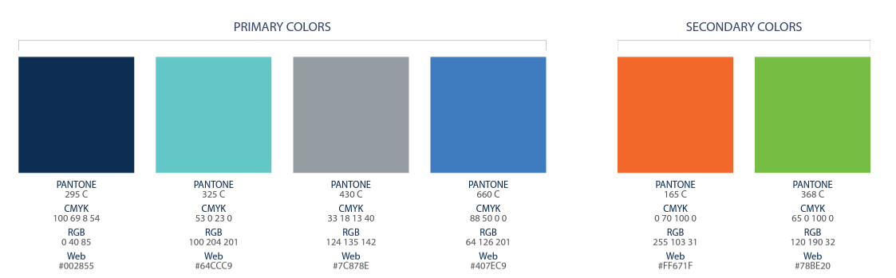
Notes:
Introduce yourself and tell your story MAX 1 minute (CLICK)

Slide 16


Notes:
Before we get started, I want to let you know this is a business and as with any business, if you do nothing you will earn nothing, and ACN cannot guarantee your results.
With that, let me introduce you to ACN. (CLICK)

Slide 17

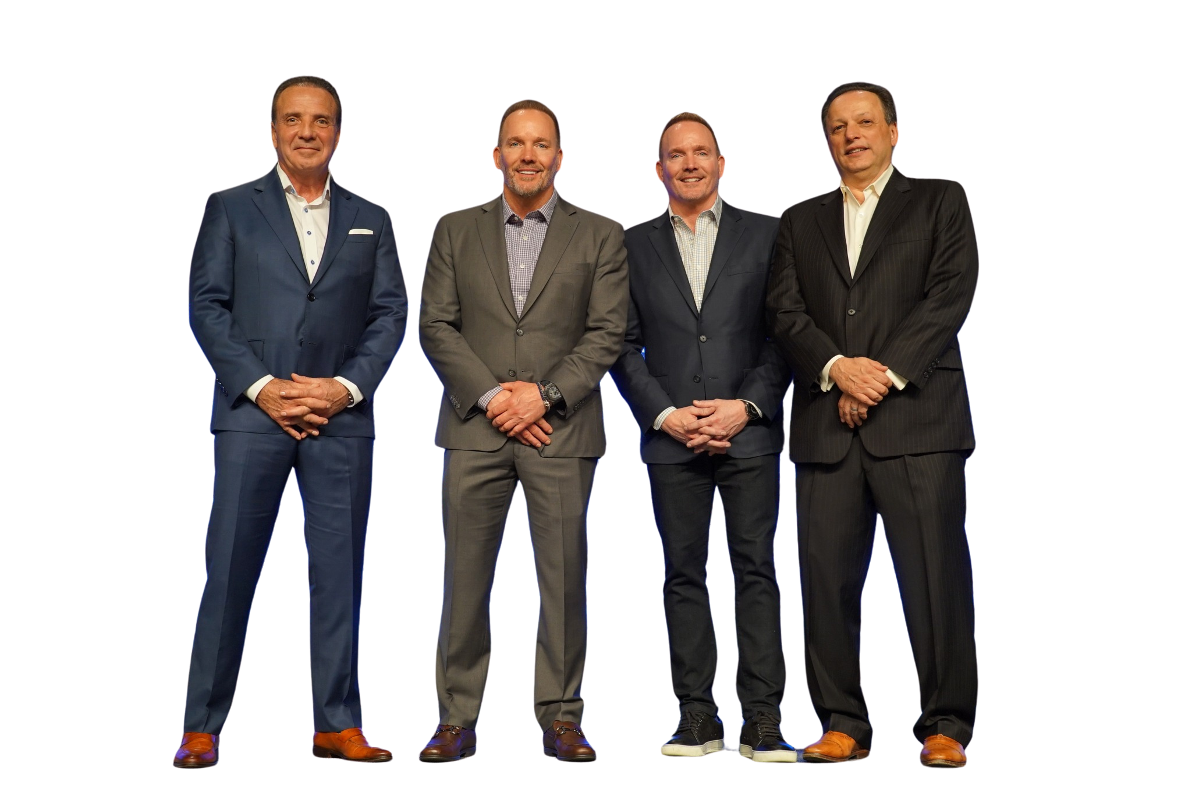



















Notes:
ACN was founded in 1993, and today we do business all across the US & Canada. (CLICK)
In our 30+ year history, we’ve helped millions of customers with our services and have generated billions of dollars in revenue. (CLICK)
ACN has an A+ rating with the Better Business Bureau and was recognized as one of the fastest growing companies in the Inc 500. (CLICK)
ACN also has a strong tradition of giving back. Through our partnership with Project Feeding kids, a child is fed every time a customer is acquired. And ACN is also a proud supporter of the local Ronald McDonald House Charities
What does this mean to you? It means that our company has credibility...and heart...and is a company that you can count on with a proven track record of success.
So, how did ACN get started? (CLICK)

Slide 18


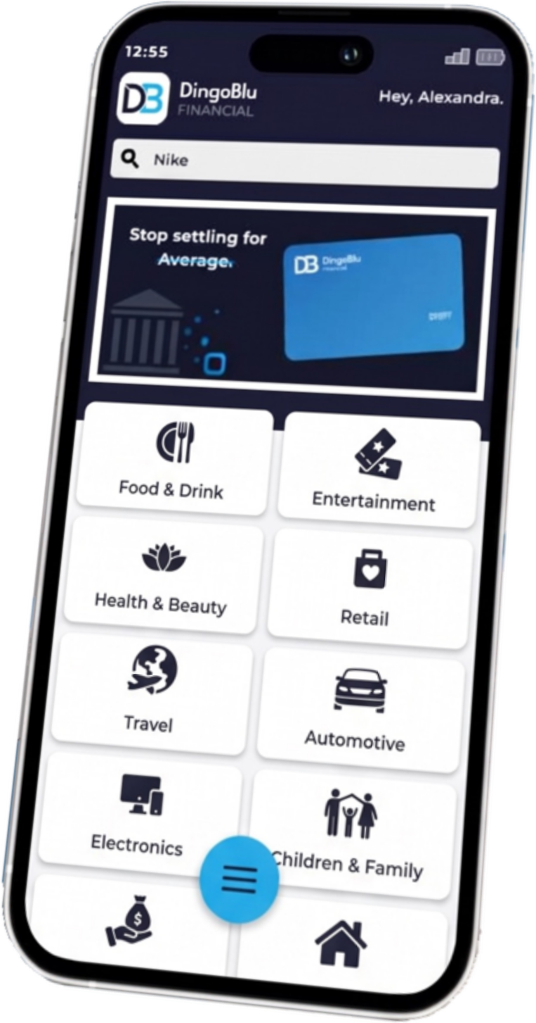




Notes:
Since the 80s numerous industries have been deregulated, beginning with long distance and continuing with Energy and Wireless with many more to follow.
Deregulation causes disruption, which in turn creates an opportunity for others break into that market.
So, in 1993 when ACN got started , they took advantage of industry disruption to create opportunity for all us in the form of residual income. (CLICK)

Slide 19


Notes:
When residual income is part of your financial portfolio, you continue to earn month after month on something you did only one time.
In fact, Residual income is the kind of income that the wealthiest people in the world use to leverage themselves so they can build wealth.
Here's what that looks like with ACN (CLICK)

Slide 20








Notes:
You have the opportunity to earn income monthly on the services that people use in their home and business every day and pay for every month.
Services like Mobile phones, Energy, Healthcare, TV, Internet and more.
Services we can't live without.
So, let's take a look at those services and also take a peek into what's coming later in 2026 as ACN continues to grow and expand its' suite of services. (CLICK)

Slide 21









Notes:
These are our trusted partners, many of which are household names, like Vivint Home Security, Direct TV, and AT&T

Slide 22











Notes:
Most service providers create online ads, radio ads, tv ads, and pay high priced celebrities to promote their product in hope of getting customers.
ACN uses the most effective form of advertising there is - Word - Of - Mouth
A friend telling a friend. (CLICK)
So rather than paying for high priced ads or celebrities, ACN inserts YOU into the equation.
When you bring customers to ACN, giving them more choices, ACN pays you! (CLICK)

Slide 23










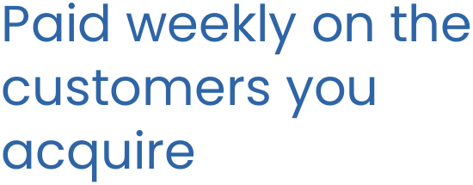
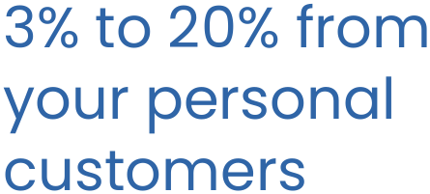
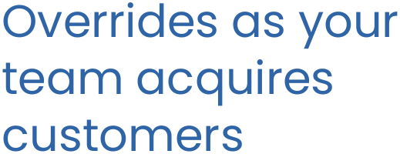

Notes:
There are 4 ways to earn with ACN (CLICK)

Slide 24
























Notes:
The first way you can earn, is with up-front bonuses
When you enroll just 3 services in your first 30 days. ACN will send you a $300 Bonus!
Enroll more services and you can earn more bonuses.
When you enroll just 3 more services in your first 30 days (CLICK) ACN will send you an additional $400 bonus for a total of $700.
(CLICK a total of 4 times as you say the next sentence) - And each time you enroll 3 more services in your first 30 days, ACN will send you an additional $400 bonus. You can earn as much as $5,100 each month, by enrolling customers. (CLICK)

Slide 25










Notes:
The second way ACN compensates you is through monthly residual income you earn when your personal customers pay their bills.
You begin by earning 3% on the commissionable revenue on the first customers you enroll. (CLICK)
As you enroll more customers the percentage you earn also increases.
Once you have enrolled enough customers you will earn monthly residual income as much as 20% on the commissionable revenue from all your personal customers.
Now, what if you showed other people how they can get paid to do the same thing - and you built a team? (CLICK)

Slide 26


Notes:
JP Getty said it best, “I’d rather have 1% of the effort of 100 people than 100% of my own effort.”
This business isn’t about you going out and getting 1000’s of customers yourself. It’s about getting a handful of customers and teaching others to do the same. (CLICK)

Slide 27












Notes:
So, let's see what's possible when you build a team... (CLICK)
As your team grows you can promote to higher ranks. And this is the third way you can earn. (CLICK)
When you promote to the first leadership position of Executive Team Leader, ETL, you will begin to earn overriding customer acquisition bouses up to $50 each time a new team member enrolls 3 new services in their first 30 days of business. (CLICK)
As you promote to higher ranks you can earn up to as much as $400 each time a new team member enrolls 3 new services in their first 30 days of business.
These bonuses go to unlimited levels. That's significant income as your build and grow your ACN business!
Remember, in order to earn that bonus, those people on your team had to enroll customers. What are those customers going to do every month? Pay their bills. And when they do, ACN will pay you an override of up to 4% on all of your team’s customers! (CLICK)

Slide 28

Notes:
Now imagine earning up to 4% on the commissionable revenue of all your team's customers.
(CLICK) In this example, you sponsored 4 team members who each enrolled customers.
Those team members want to do the same thing you did, build a team to create leverage. (CLICK - the animation will continue as you say the rest of the dialogue),
So, they sponsor a few, who sponsor a few, who sponsor a few...giving you the opportunity to earn income on the efforts of hundreds or potentially thousands of team members
Now THAT is significant income potential. (CLICK)

Slide 29




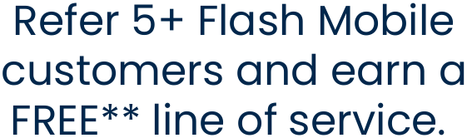
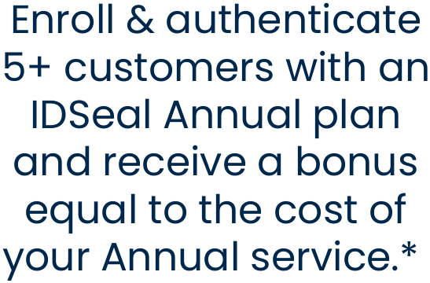
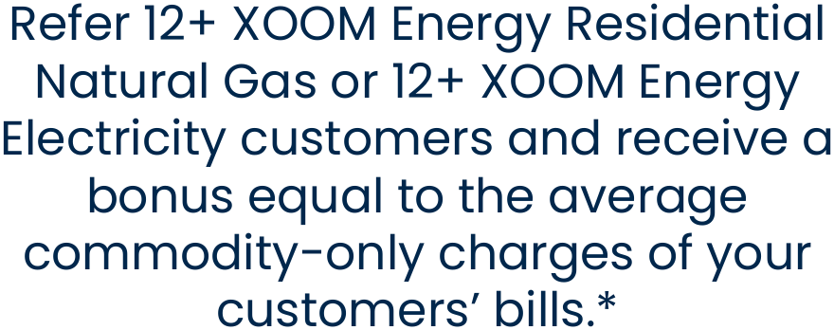
Notes:
ACN also has a robust referral program. Refer a few friends to use our services and you have the potential to get your service for free.
Get with the person who invited you, to get more info on this valuable program. (CLICK)

Slide 30
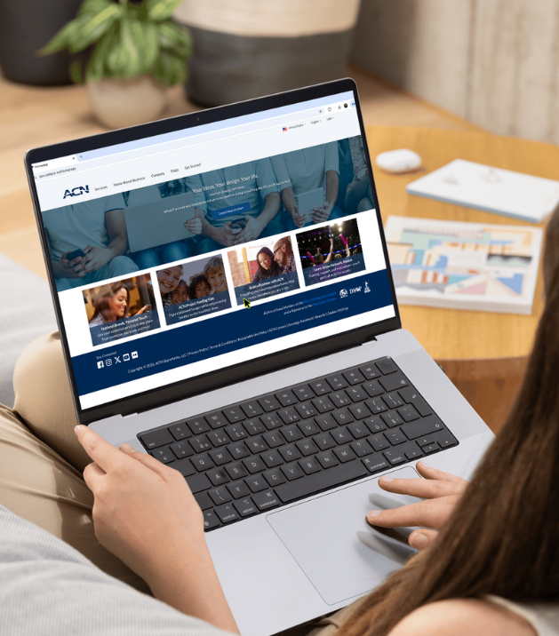






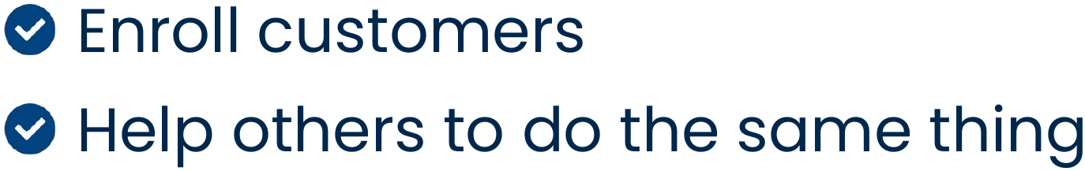
Notes:
Now let’s look at what it takes to get started.
To become what we call an IBO, an Independent Business Owner, it’s a one-time fee of $299 and a monthly business support fee of $30. This gives you everything you’ll need to build your own successful online business.
You’ll get a personalized website or “storefront” where people can go to enroll for any of our services.
A cutting-edge AI tool that you can train to work for you.
You’ll have access to all the training, tools and support you need and will have a complete back-office reporting system to be able to track the growth of your business in real time right from your phone.
This is a low-risk, low overhead business with a substantial opportunity to earn. (CLICK)

Slide 31





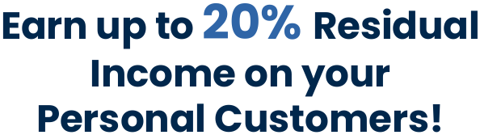
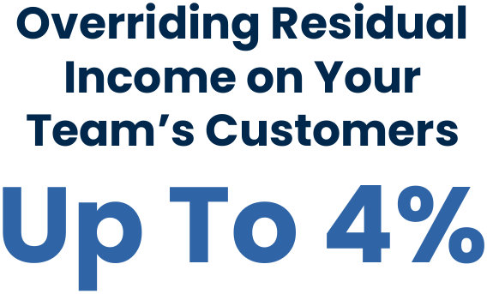

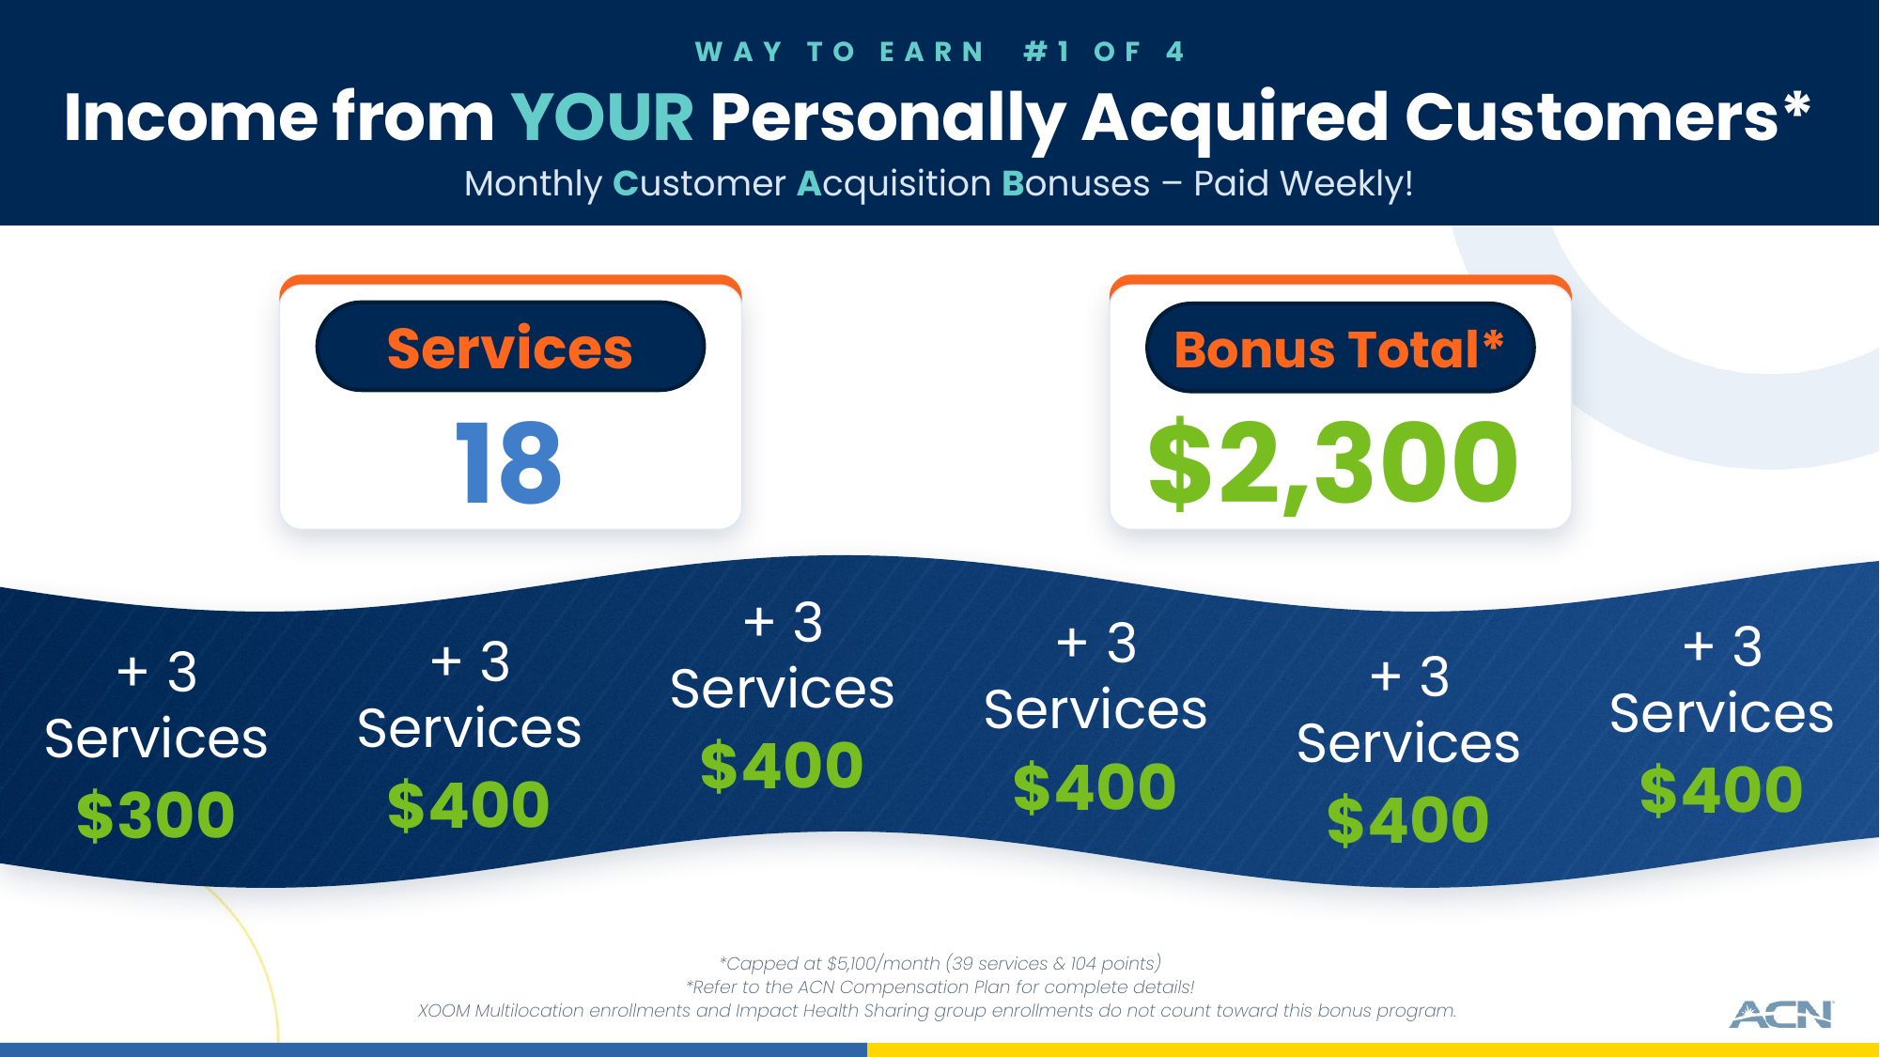
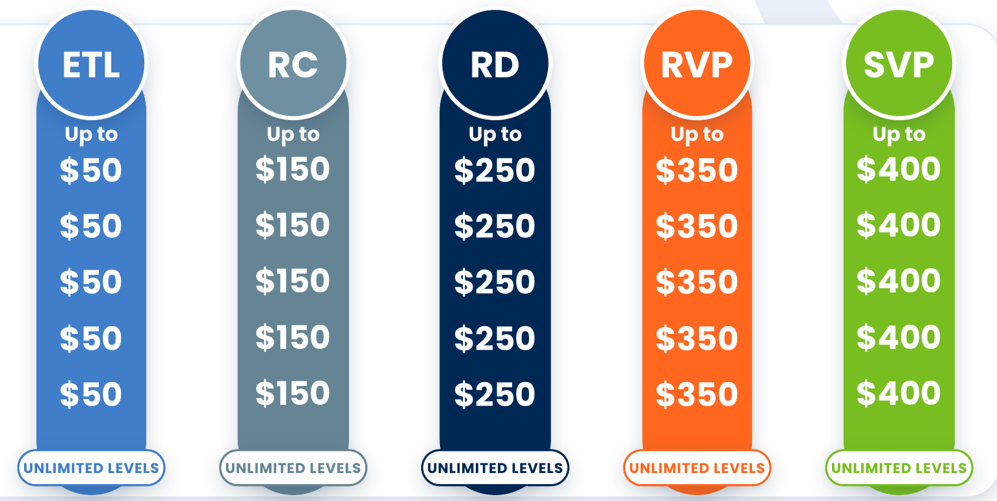







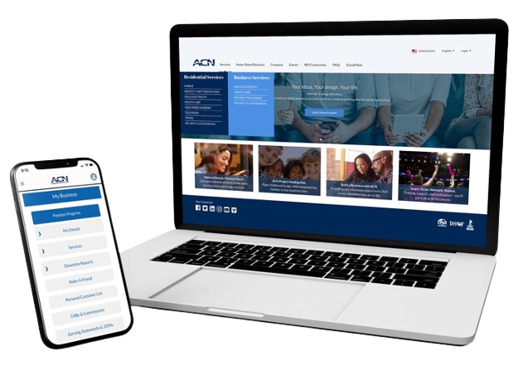




Notes:
Let’s review what you get.
As a customer or business partner, you get better value on services you are already using and by default you help to feed a hungry child through project feeding kids!
As a business partner...
You can take advantage of our referral program to earn free services
Get the tax benefits of business ownership
Earn Residual income on your personal customers and your team's customer
Earn bonuses from enrolling customers or when your team enroll customers.
Partner with a company that has a track record for success
Run your business from anywhere and have access to 8 residential and business services
And very soon, you can take part in the Exclusive launch of Fintech Banking and build financial security for you and your family! (CLICK)

Slide 32



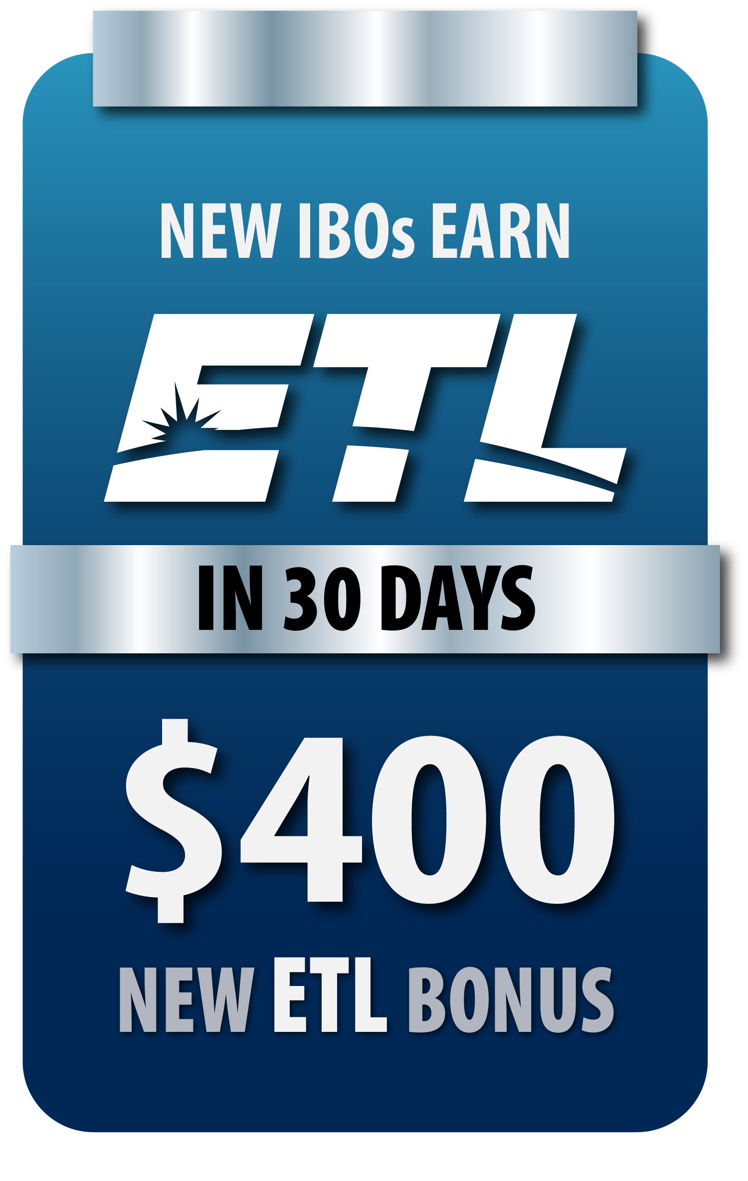


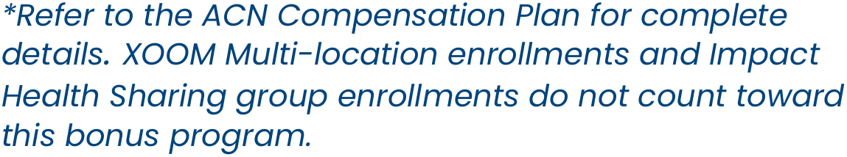


Slide 33







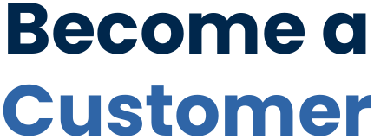
Notes:
By now you are likely one of 3 people…
You’re excited and ready to get started: If that's you, get enrolled right away and attend training! (CLICK)
Perhaps, you are interested, but you want to learn more: Get with the person who invited you to get your questions answered and then attend training, so you can get more info! (CLICK)
Perhaps, this isn’t the right time for you: Let the person who invited you know and talk with them about becoming their customer. They will appreciate it more than you know! (CLICK)

Slide 34


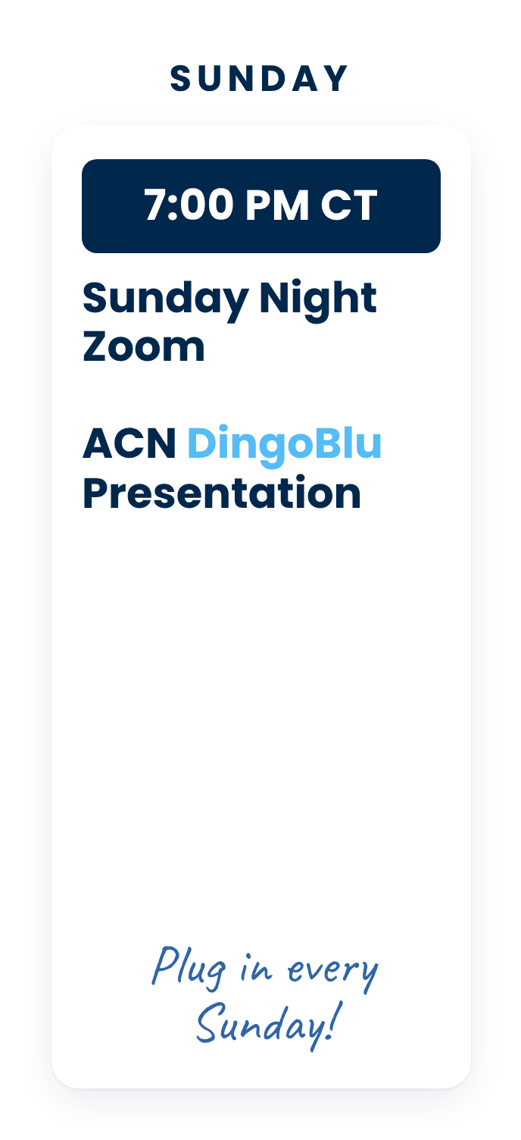
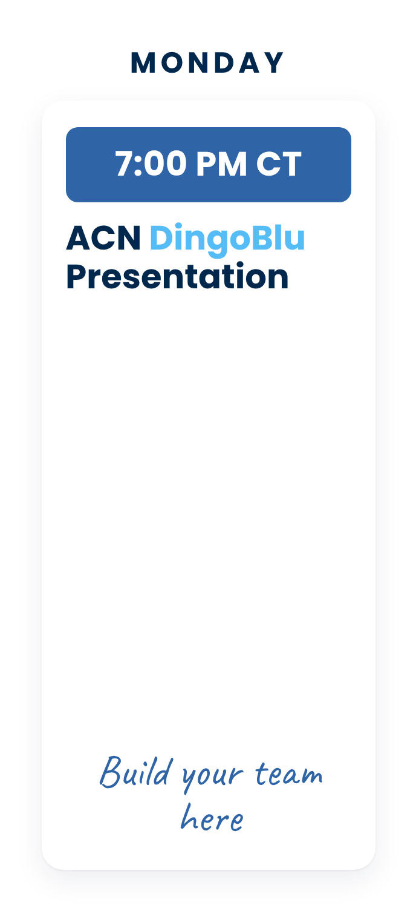
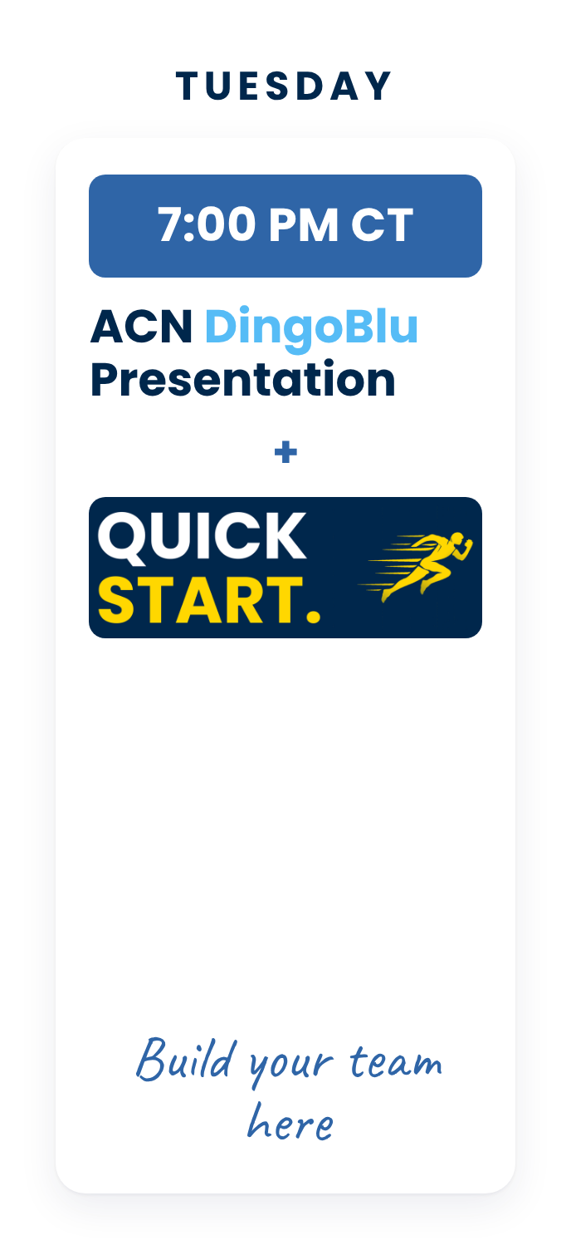
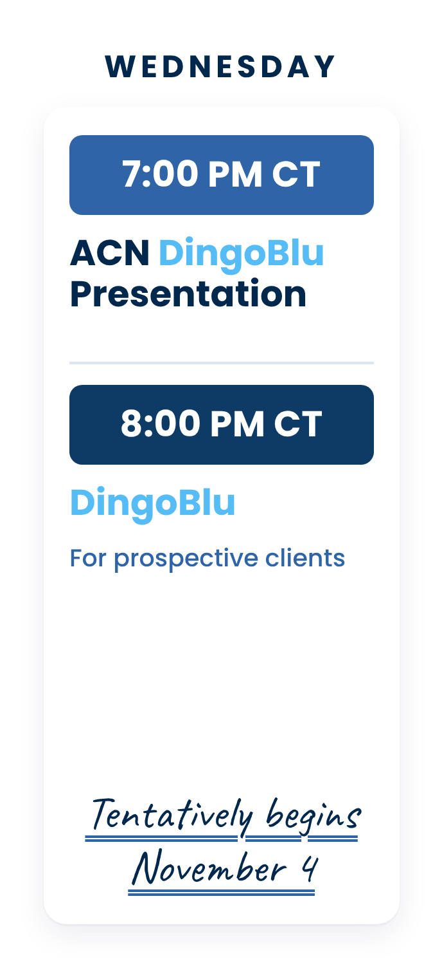
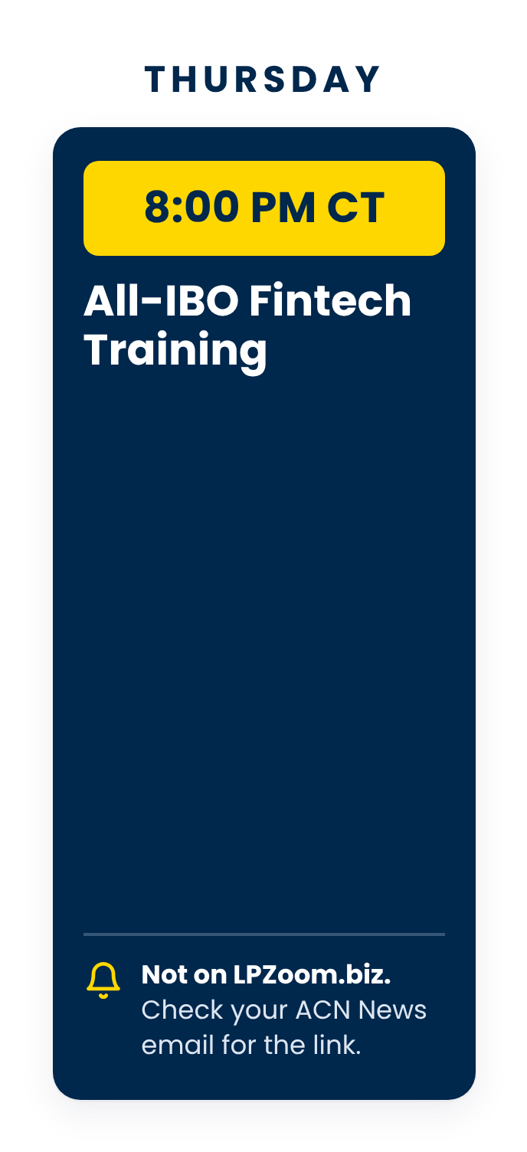
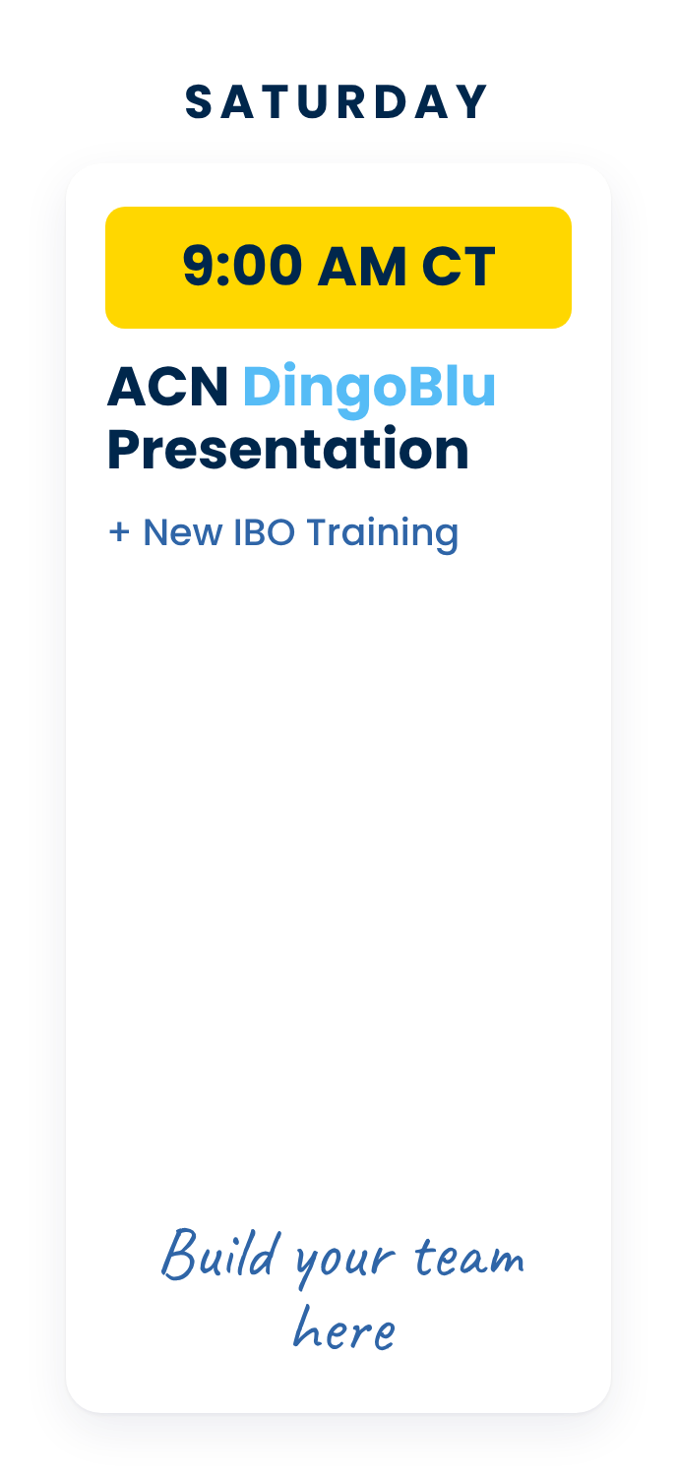

Notes:
Our team, Legacy Partners, is here to support you with virtual presentation and trainings 6 days a week.
Feel free to join us during any of these events and guests are always welcome to join us!
There is a business overview every day of the week, except Thursday and Friday.
On Wednesday Evenings, we have TWO events. (CLICK) A business overview at 7 p.m. CT followed by a (CLICK) DingoBlu Informational Zoom at 8 p.m. CT - Beginning Oct 28 - which is a great event to invite your prospective Impact customers or to learn more about DingoBlu yourself.
ACN hosts an ALL IBO DingoBlu Zoom training on Thursday evening at 8:00 p.m. CT. Please refer ton your emails from ACN
Then finally a business presentation on Saturday Mornings at 9:00 a.m. CT followed by a deep dive into the ACN compensation plan and a training on how to get started right! (CLICK)

Slide 35





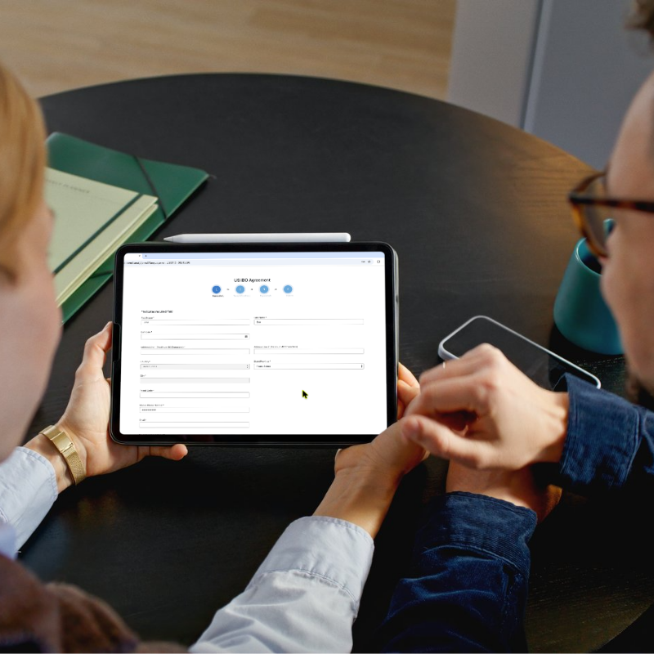

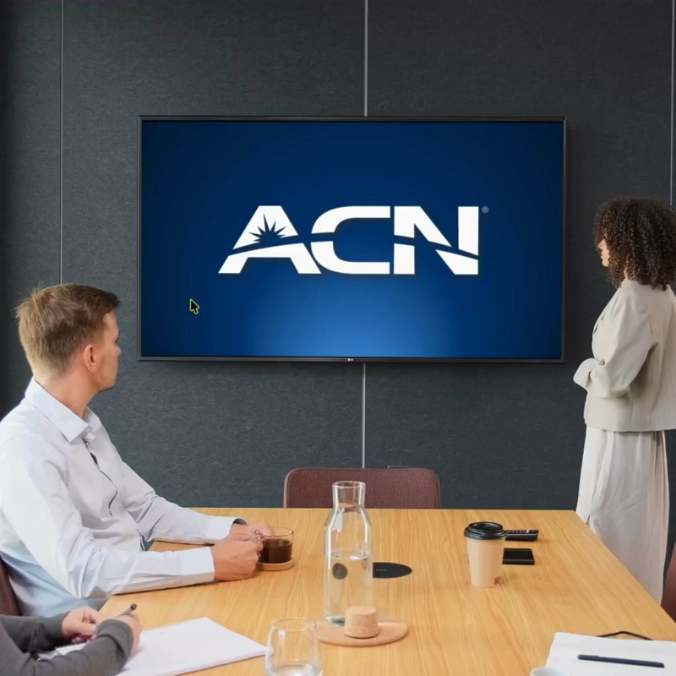
Notes:
Now, if you’re like I was when I first saw this, you’re probably excited. If you’re ready to get started, get with the person who invited you, and they will help you enroll as an IBO. Remember, you’re in business for yourself but never by yourself. We have a great system in place to help you get off to a fast start, so plug into our trainings, learn the basics and start acquiring your customers and building your team. (CLICK)

Slide 36

Notes:
The first big training event of 2027 is coming up this March in Orlando, FL.
Learn from some of the best trainers in the company
Connect with vendors from all our services
Make important connections from IBOs around north America
Connect with other Legacy Partners team members and have a great time!(CLICK)

Slide 37

Notes:
I want to thank you for taking the time to watch this presentation and let me be the first to welcome you to the team!

